Slide 1

Practical elements
of OPW Environmental GIS Specification
Tony Brew
Environment Section OPW

Slide 2
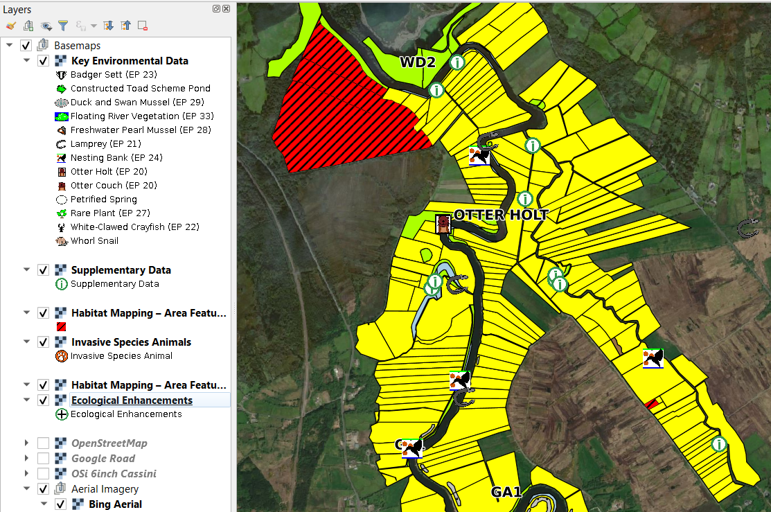
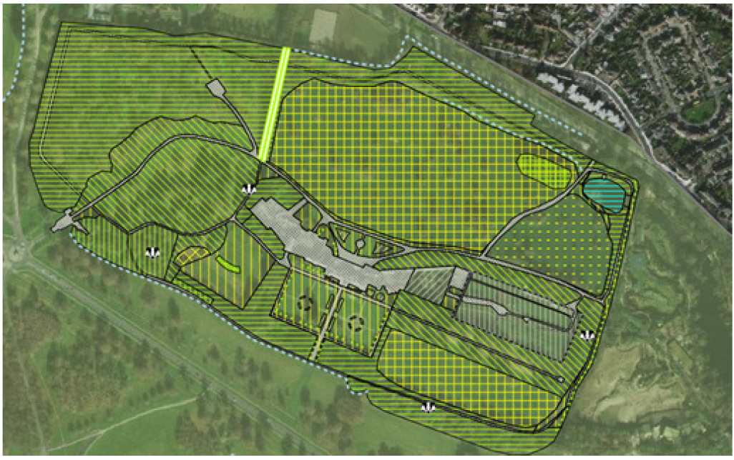
Aims of data specification
Produce clean data
Flooding/drainage process a large amount of ecological assessments
Use data to create procedures.
Use data to limit impacts
Viewers, layers and icons to communicate with ground staff
Habitat mapping carried out by consultants, other datasets require input by staff, habitat mapping hatching developed based on the Heritage Council’s colouring system
NHP

Slide 3
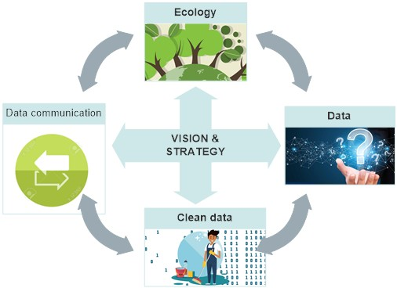
Project risks of
developing spec.
Requirements of stakeholders.
No “buy in”
Communication
Consultation
Training
Too complicated
Data recording and storage
Key fields not incorporated
Merging data
Missing key requirements
Other databases and systems.
Implementation

Slide 4
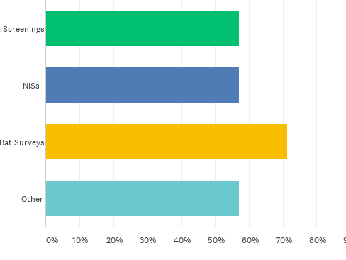
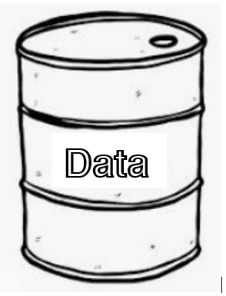
Key Fields that organise data
Consultation
A bat roost is found in the magazine fort in Phoenix park. The location is associated with the property location.
This should be inputted into the Key Environmental Data layer.
ked_id | s | ast | ttt | pcd | a | rn | ked_type | date | sou | comment
20210101 | hp | 205120 | ked | 104140 | f | 01 | bat roost | 010121 | ABC Cons | south eaves
Sections represented in
Questionnaire
Office of State Architect
NHP Heritage Services
Property Maintenance
National Historic Properties
National Historic Properties
Environment Section
National Botanic Gardens (NHP)
Estate Portfolio
s | Section
ast | Building / Monument Code or Tree Tag no
ttt | Layer Code
pcd | Property Code
a | Status
rn | Revision

Slide 5
Building on Flooding specification
Spatial Data File | Description | Estate portfolio object | FRM object
Invasive Species Plants | SI 477 plants | Point | Point
Invasive Species Animals | SI 477 animals | Point | Point
Habitat Mapping - Area | Fossit code habitat-areas | Polygon | Polygon
Habitat Mapping - Line | Fossit code habitat- lines | Line | Line
Ecological Enhancements | Artificial habitats | Point/Polygon for landscapes | Point
Key Environmental Data | Important/protected species | Point | Point
Supplementary Env. Data | Sightings of important species | Point | Point
Project Area | FRM project extent | n/a | n/a
Image Locations | Photographs | n/a | n/a
Tree data | Not in FRM spec | Point | n/a
€1 Billion in capital investment on flood relief
Data management, conservators manage viewers
FRM staff collates/manage data
OPW biodiversity action strategy
  Data management a new action
  Required to manage and report on actions
  Broaden spec. to other sections
Flood Risk management |  | Estate Portfolio
b | River basin | s | Section, FRM spec to be changed to this
sch | Scheme | acd | Asset Code
ttt | Layer code | ttt | Layer Code
stg | Flood relief stage | pcd | Property Code
a | Status | a | Status
rn | Revision | rn | Revision
sch | Scheme
https://www.gov.ie/en/publication/b15dd0-technical-specifications-and-guidance-notes/

Slide 6











INPUT
OUTPUT
O.P.W
Habitat mapping Species locations
Invasive species locations
Sightings Annex I habitat
Corporate and heritage services Estate and flood risk management
Display Location of: Holts • Setts • Nests Hives • Trees • Plants
Key and Supplementary Data Habitat Mapping Area and Line Invasive Species Plants Ecological Enhancements
Clean Data
Protect habitats high biodiversity areas
Ecological surveys Tree surveys
Habitat and Species Mapping
Bat surveys NISs
5yr NISs
Flood relief schemes
National Repository of Information
SPECIFICATION
MANAGERS VIEWERS
Procedures to limit impacts
Avoid invasive plants and animals
Consultants Gov. agencies IFI / NPWS
OPW staff Ecologists
Data Flow within the OPW
Plan works, Limit impacts,
Measure and monitor enhancements

Slide 7

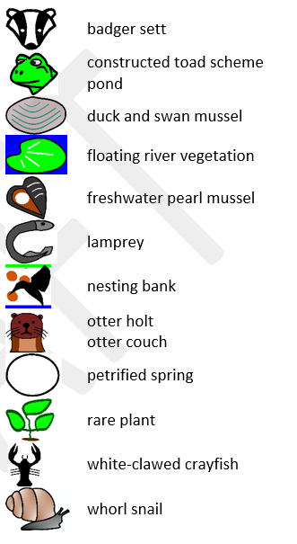
User Friendly Data
Polygons useful for wildflower meadows, biodiversity managed lawns, constructed wetlands etc.
Mapping ecological enhancements influences staff.
User friendly viewers
Easier to avoid impacts to key species

Slide 8
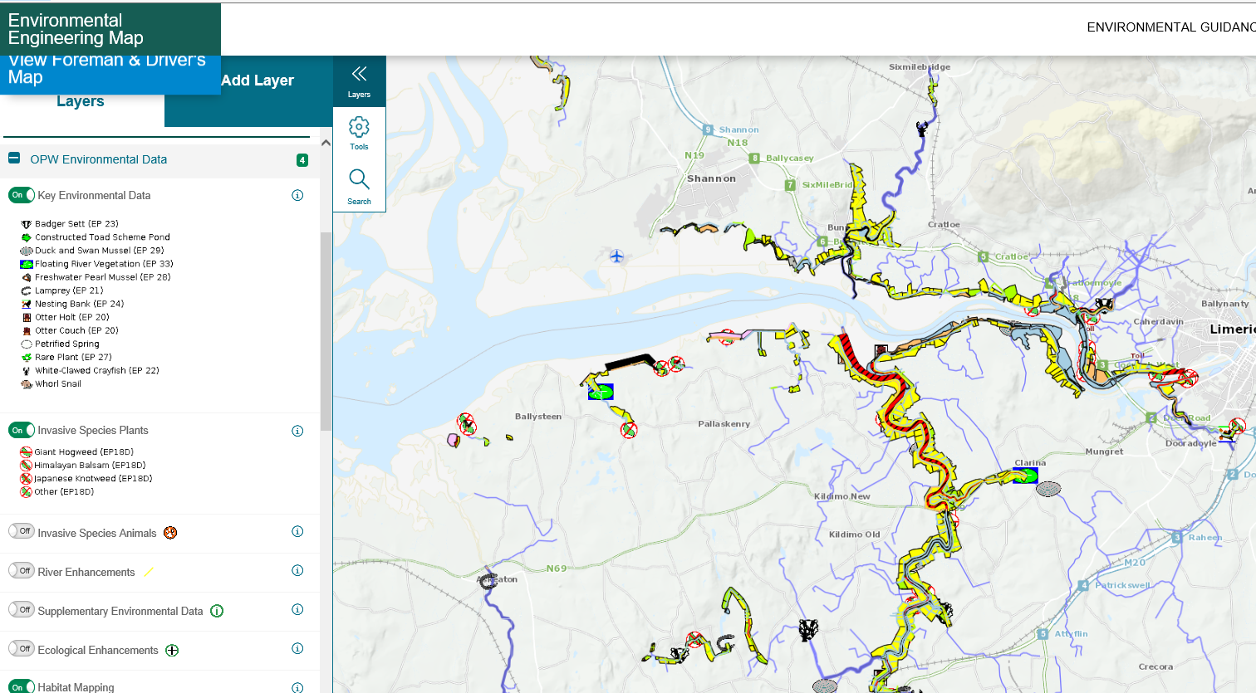
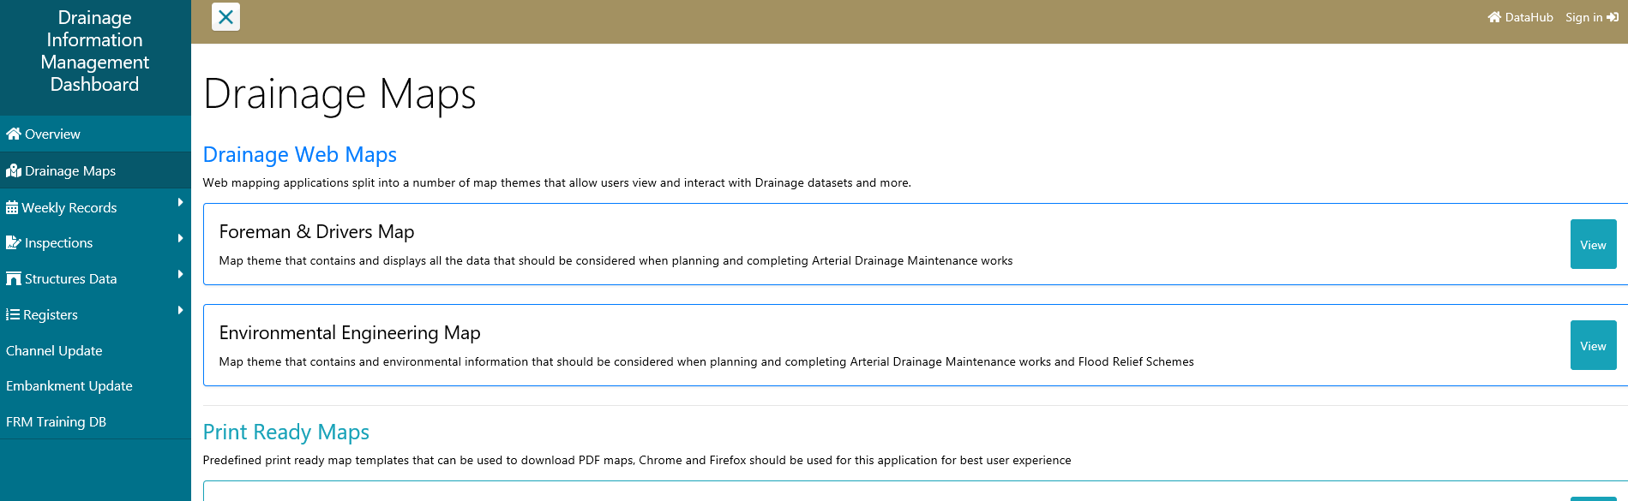

Slide 9

Ensuring data Works
Existing asset codes
Facilitate data queries
Who/how data collected
  Asset management vs individual obs.
  Consultants v staff
Data collection system
  Smart forms?
  Field collection software or not?
  Interface with mapping platform WMS
  Create shapefiles
Make data
Relevant
Objective
Accurate

Slide 10

Existing Procedures
Otter EP 20
Lamprey EP 21
Crayfish EP 22
Badger EP 23
Bank Nesting Birds EP 24
Rare Plants EP 27
Fresh water pearl mussel EP28
Swan and Duck Mussel EP 29
Floating River Vegetation EP 33
Data driven decision making, data used to limit impacts
Review map on site
Record location of newly observed species on timecard
Office will process timecard
Data received is uploaded to GIS database
Print Map
Data received is available to view on map

Slide 11
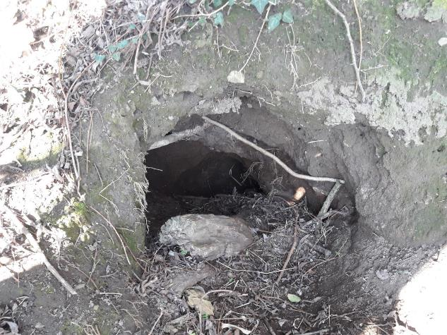
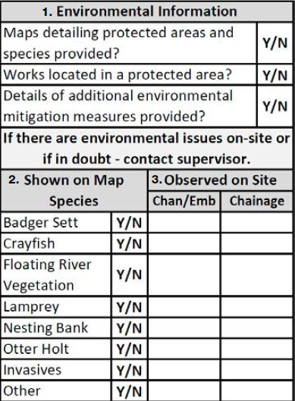
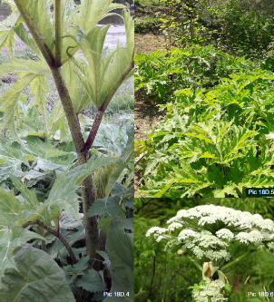
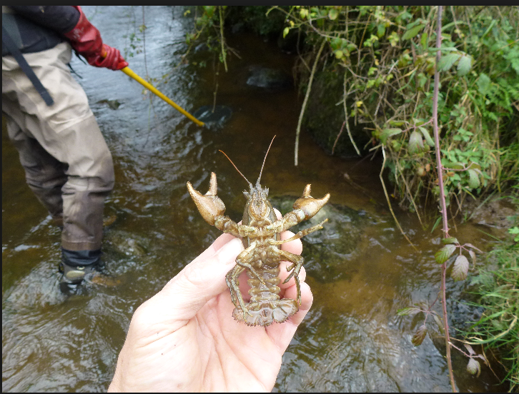
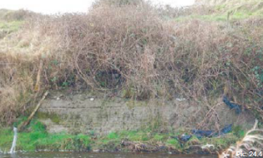
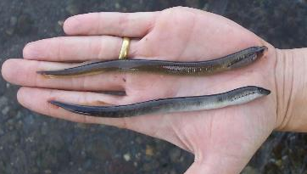
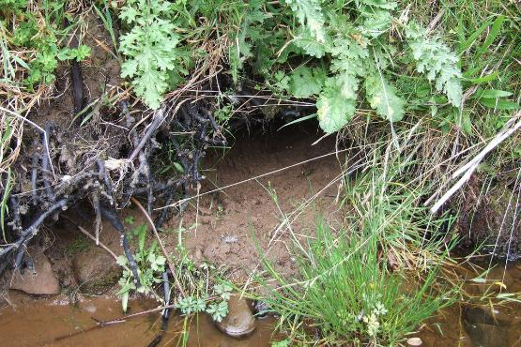
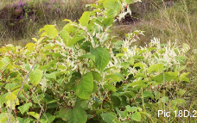
Protect

Slide 12
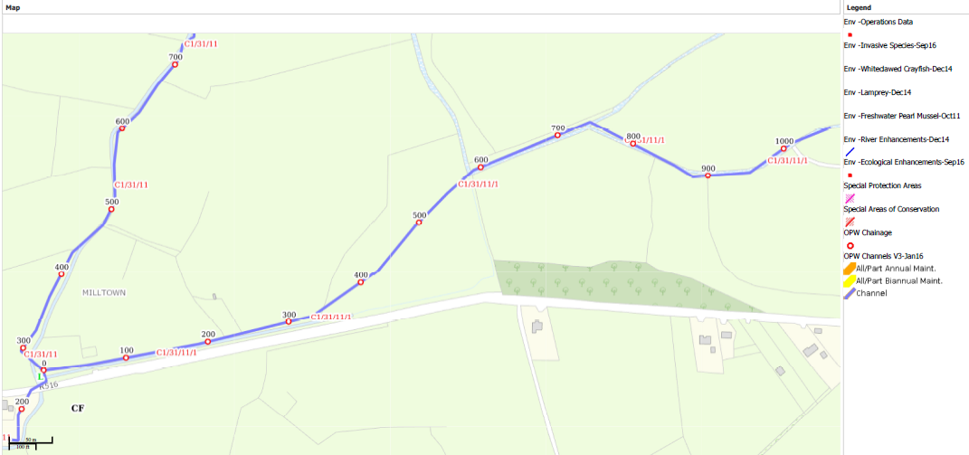
C1/31/11/1 | 690

Slide 13
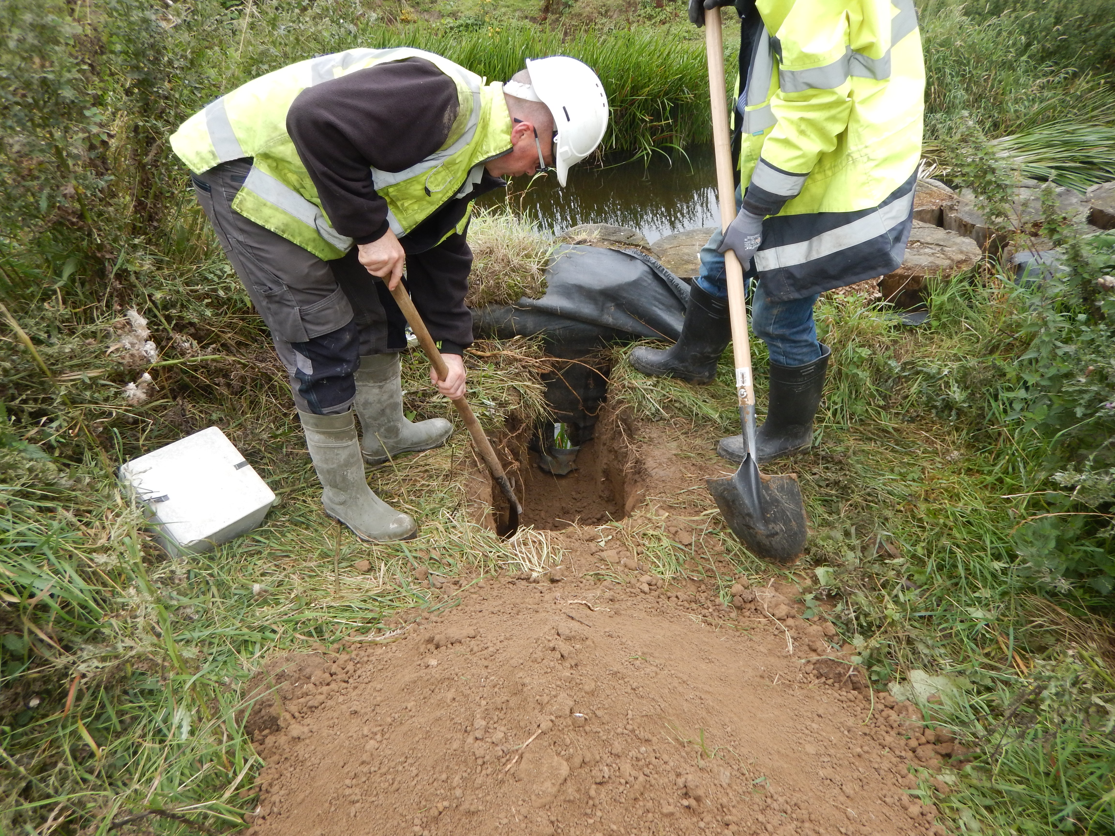
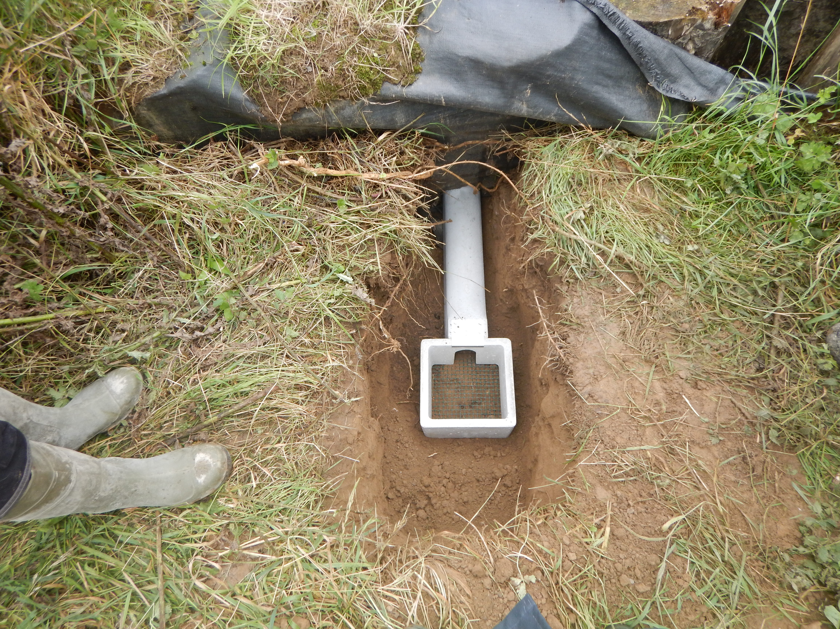
How do I get this on the mapping system
Ecological Enhancements

Slide 14
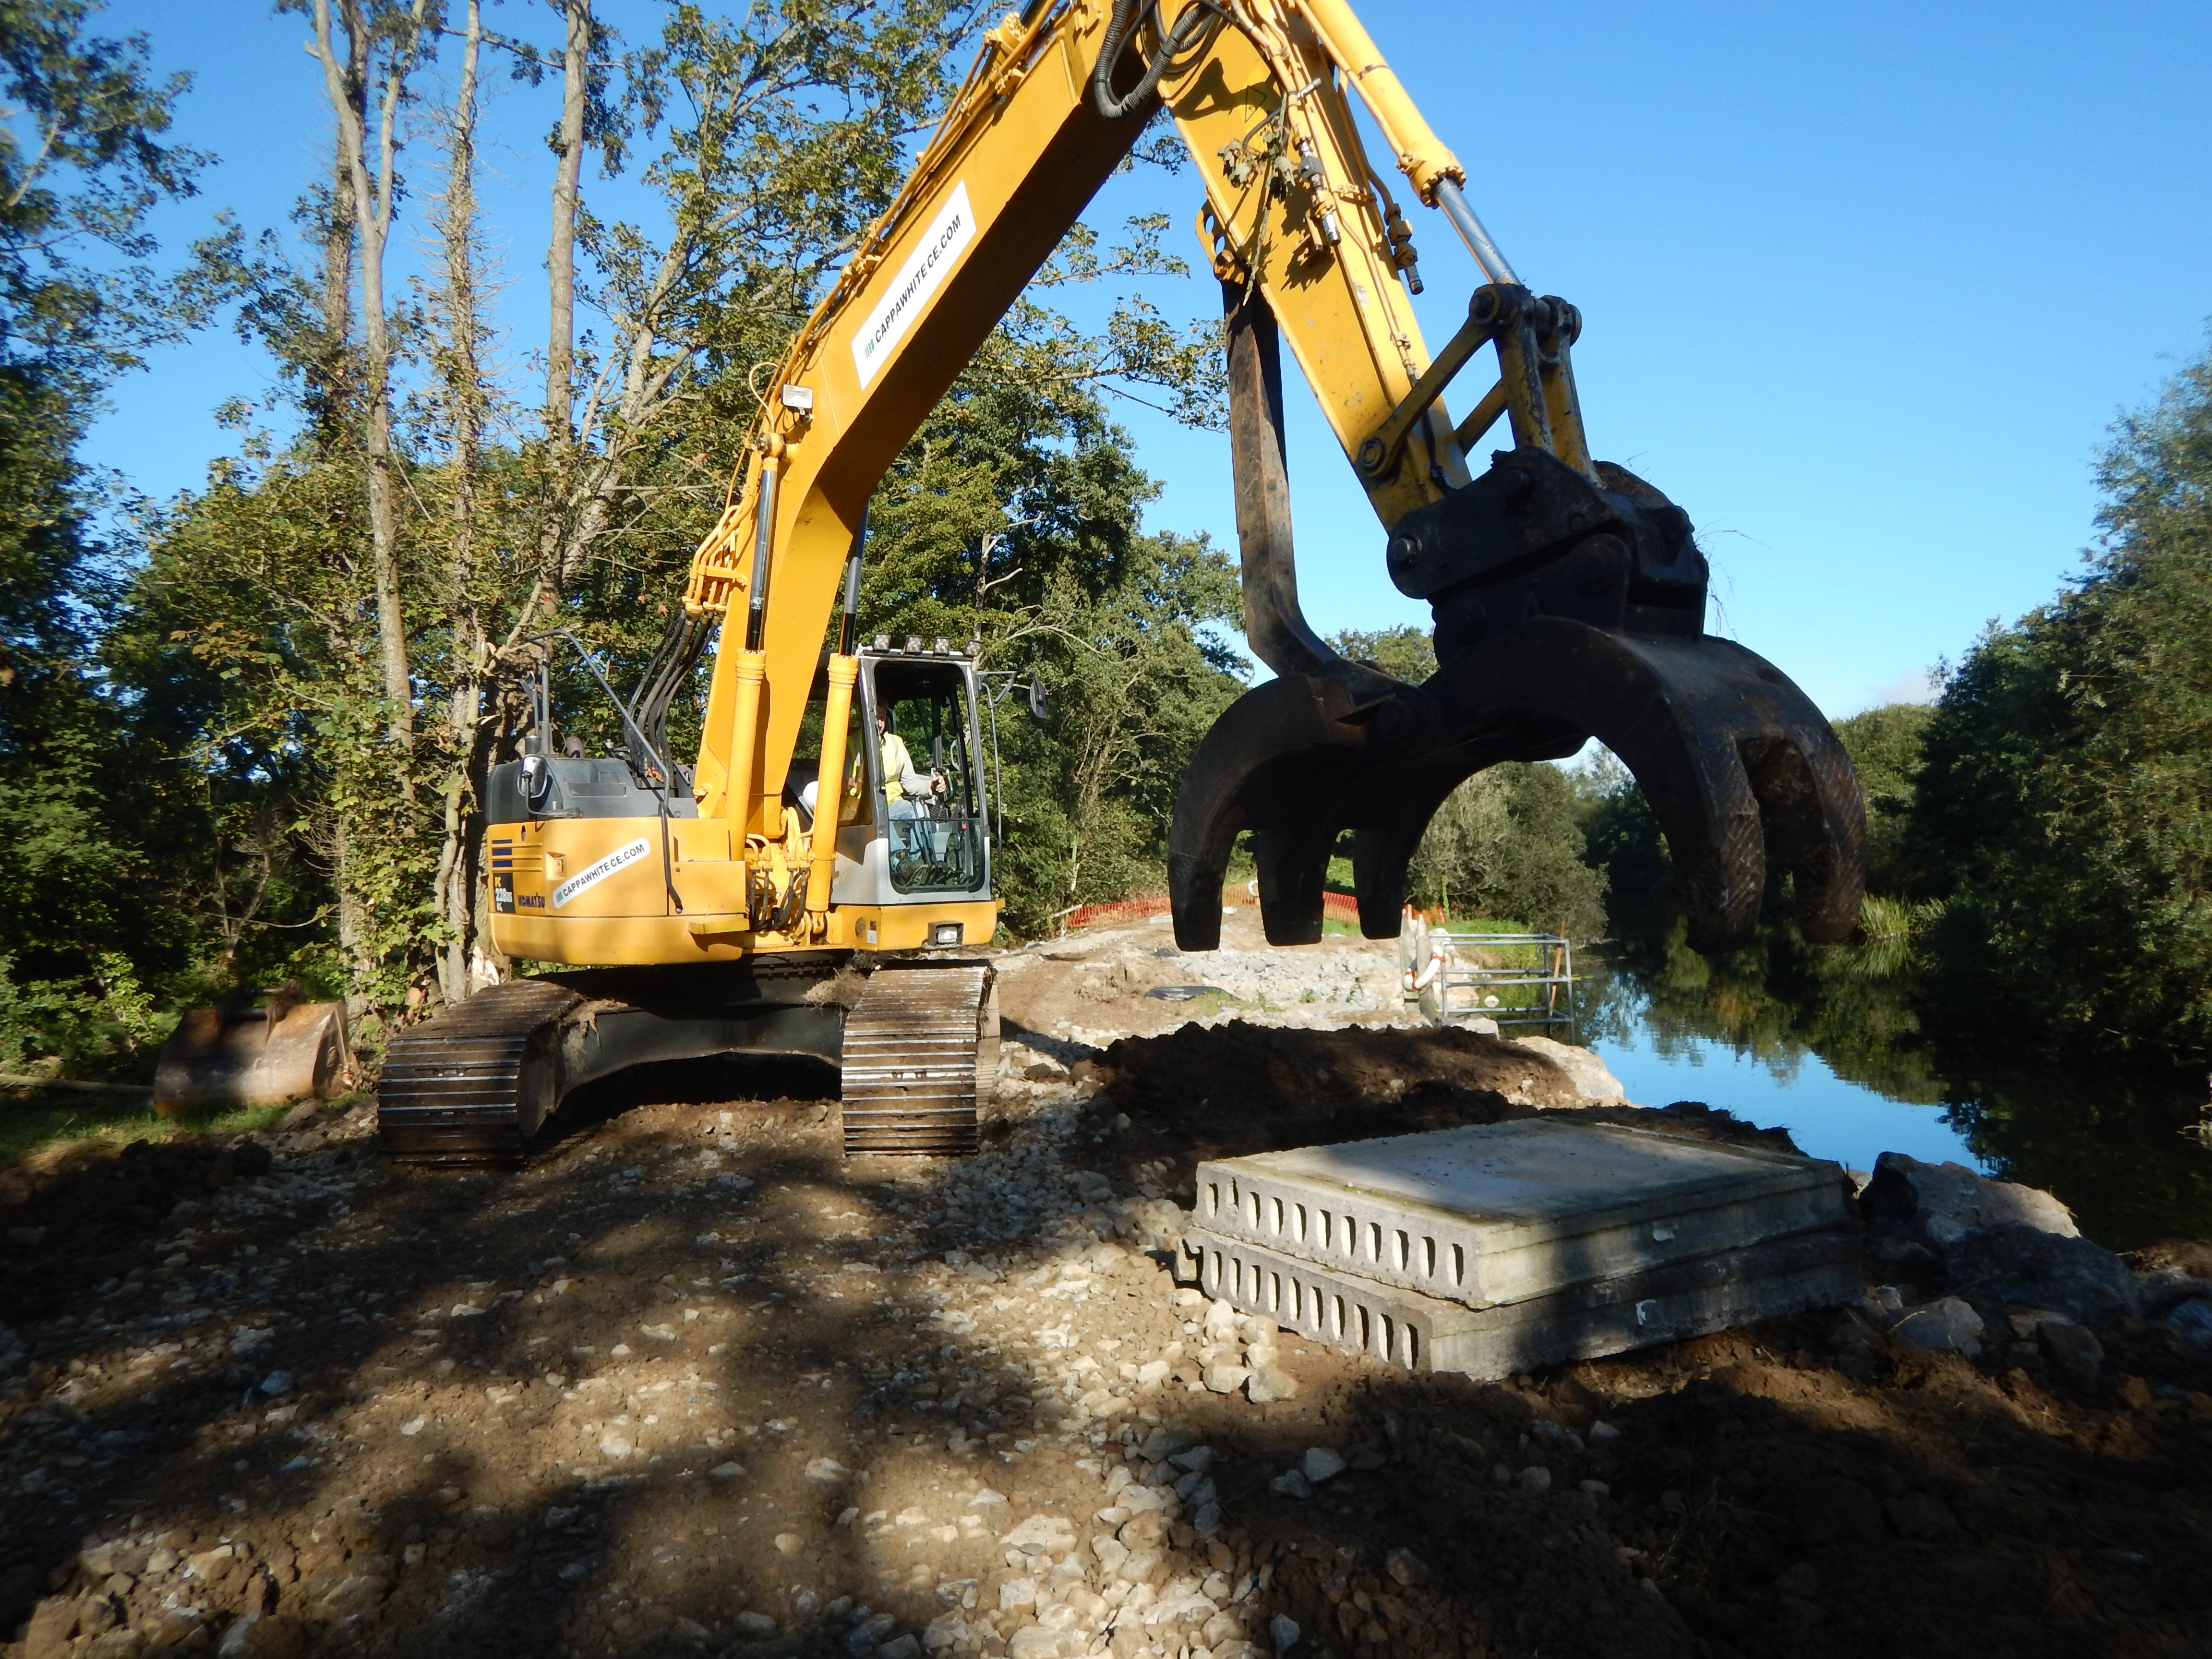
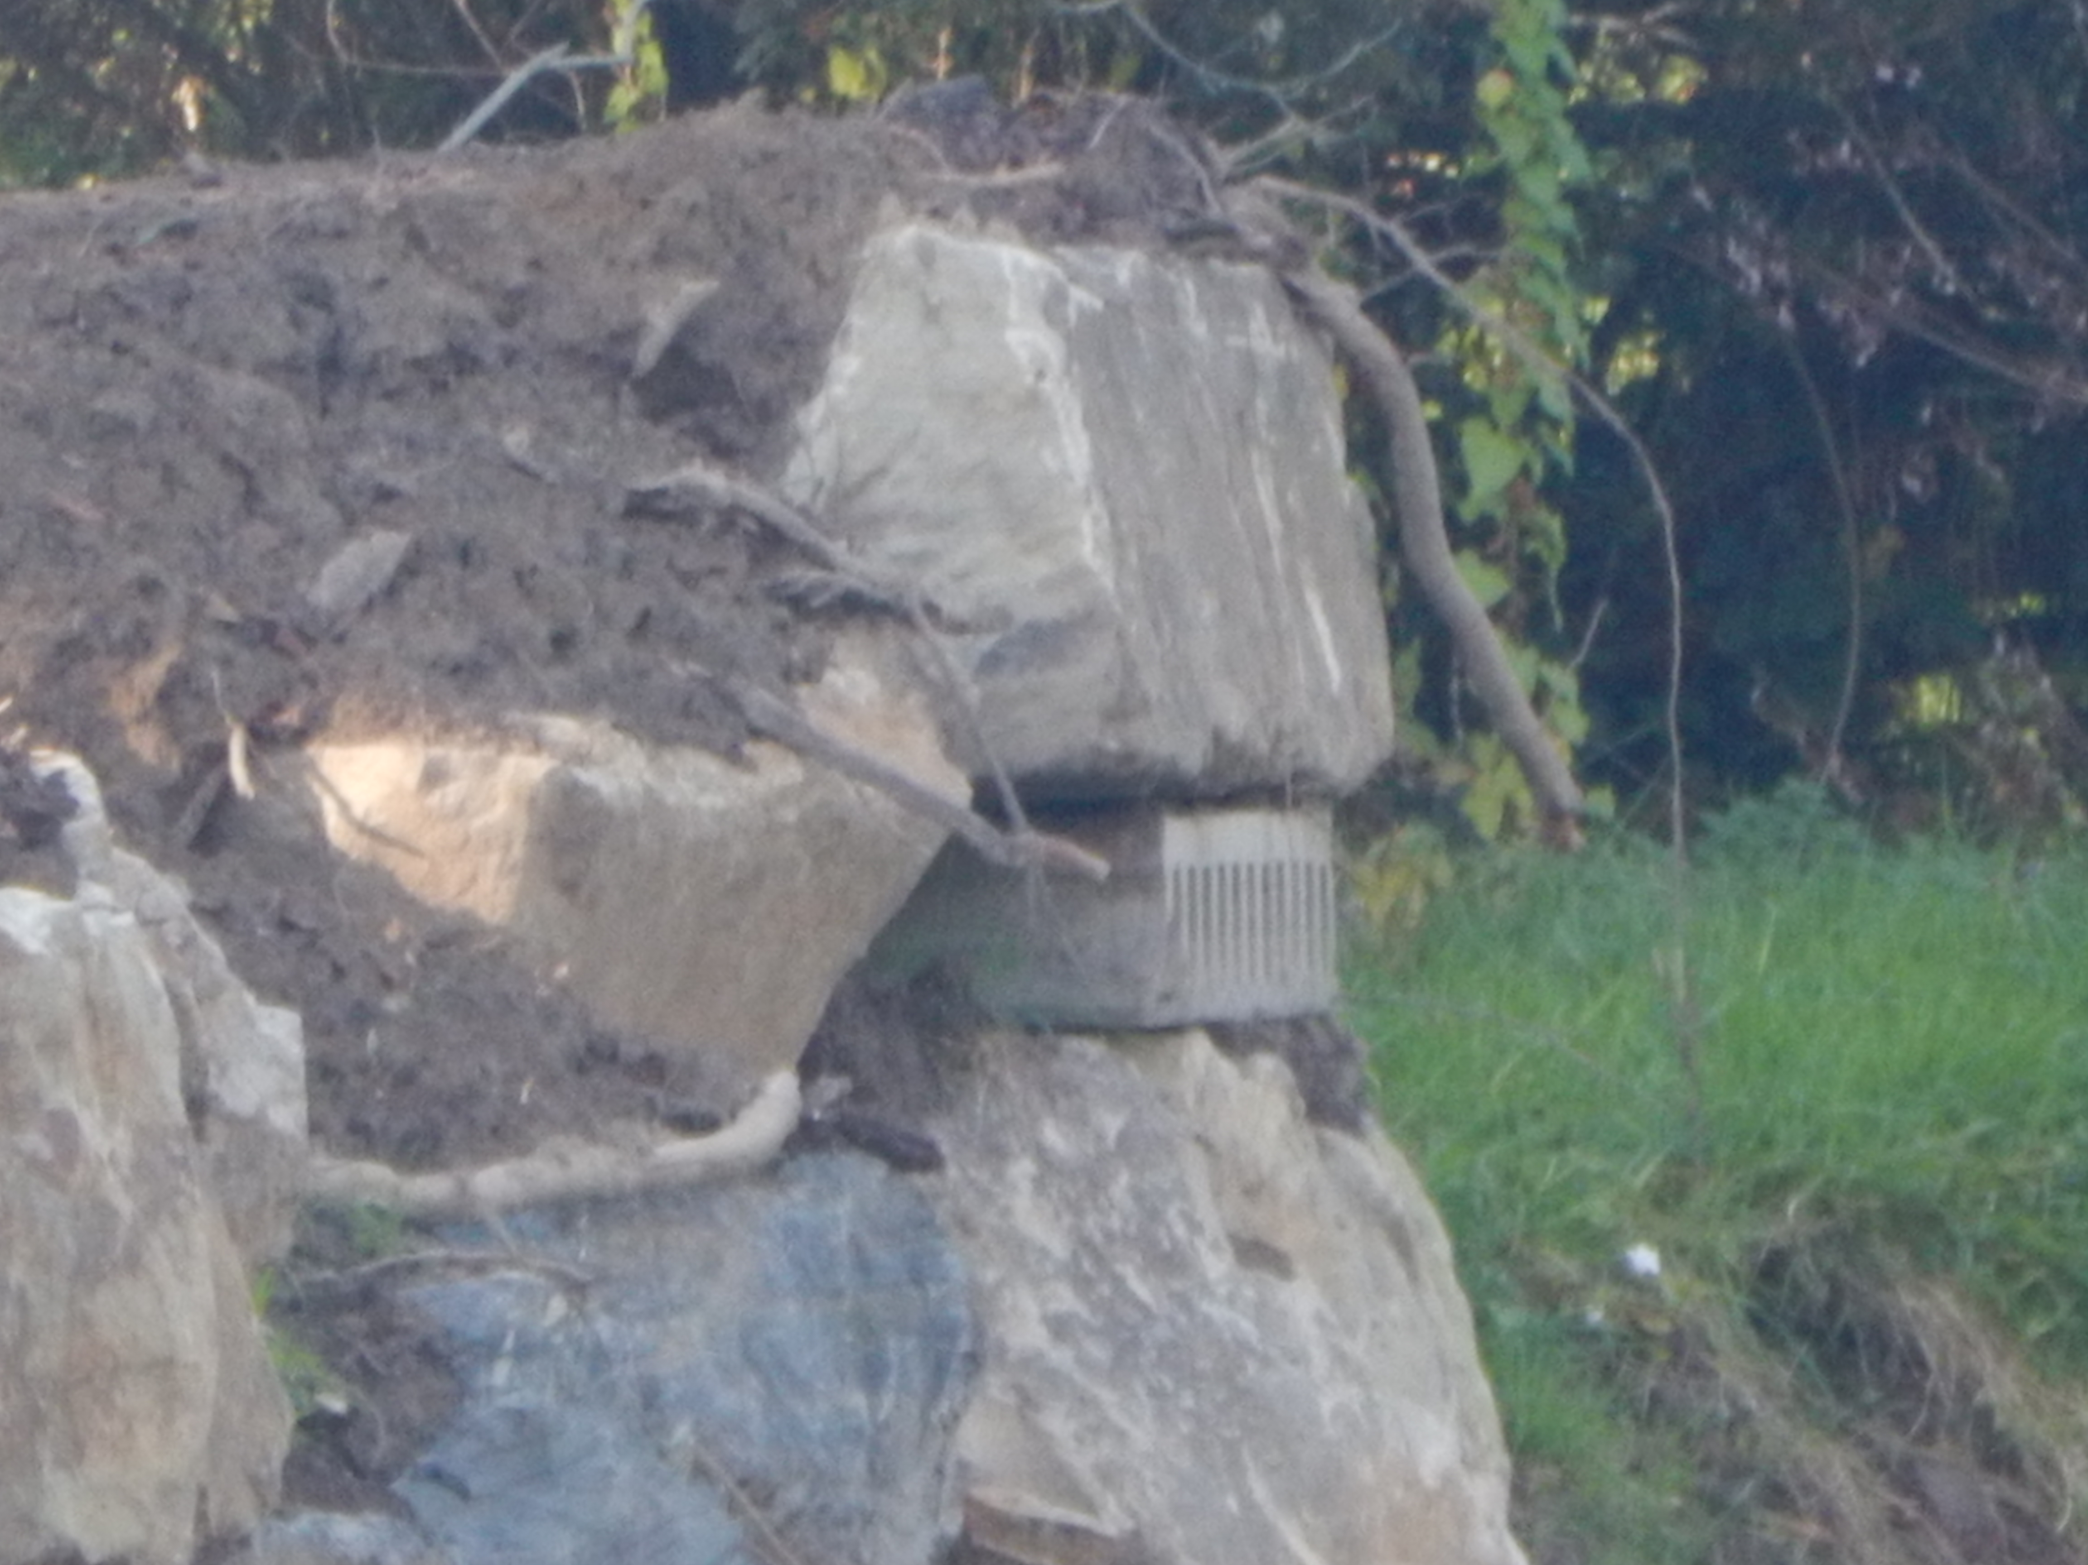
Ecological
Enhancements
Mapping can influence people to install enhancements
OPW Biodiversity Action Plan use data to
Monitor
Measure
Manage

Slide 15



Existing management systems and assets
Design spec to meet requirements of your own organisation
Habitat mapping “record status”, categorises amendments
Hatching for habitat mapping and Annex I habitats
Use attributes in file name b_sch_ttt_stg_a_rn. Work Benches
Use previous unique identifier to describe sequence
All elements prescribed, limiting observation descriptions
Collection system for field data to GIS application/viewer
Polygons/points, Some collection software no polygons
Tablets in the field
OPW Biodiversity Action Strategy
Gain “buy in”
Positives
FRM large amounts environmental data.
Delivered through the GIS Specification. Opportunities to broaden to rest of OPW
Good outcomes, promote enhancement.
Environmental reporting
Limit impacts, identified locations
Data driven decision making
Shapefiles and spec on OPW Website

Slide 16
Thank You

