Slide 1
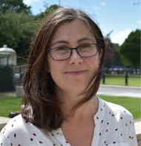
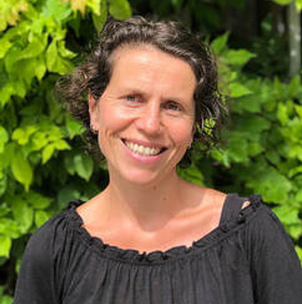
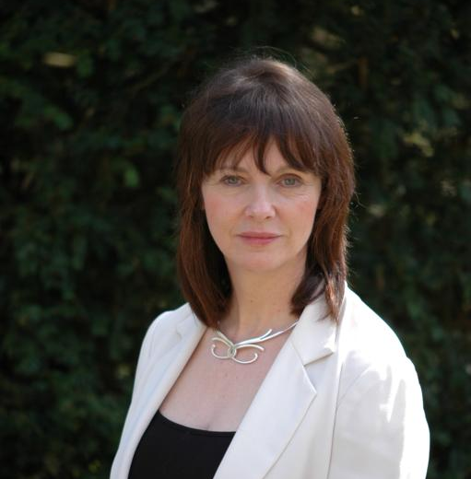
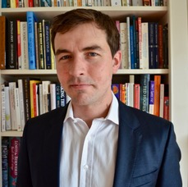
NCI Data 4 Nature
11th May 2021
https://www.incaseproject.com/
@IncaseProject
Jane Stout Catherine Farrell
Mary Kelly-Quinn Lisa Coleman
Stephen Kinsella Daniel Norton
Cathal O’Donoghue
Orlaith Delargy Fiona Smith
Carl Obst Mark Eigenraam

Slide 2
Stocks:
forests, wetlands, rivers, seagrass beds, reefs, subsoils, groundwater
Flows:
timber, fish, carbon, water, habitat, recreation, amenity, aggregates, geo-forms

Slide 3
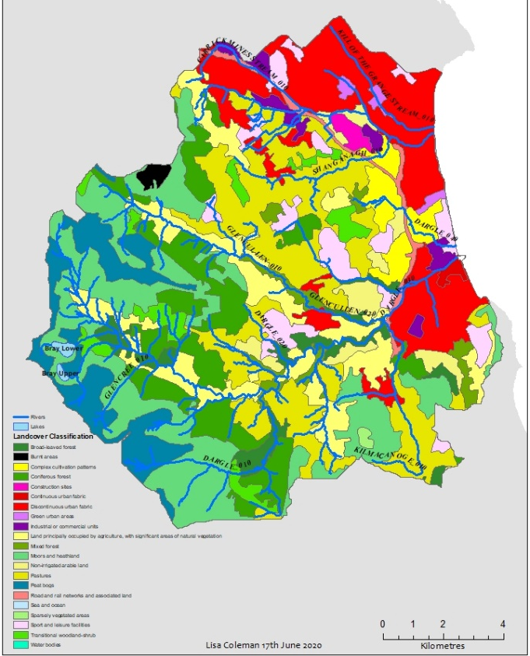
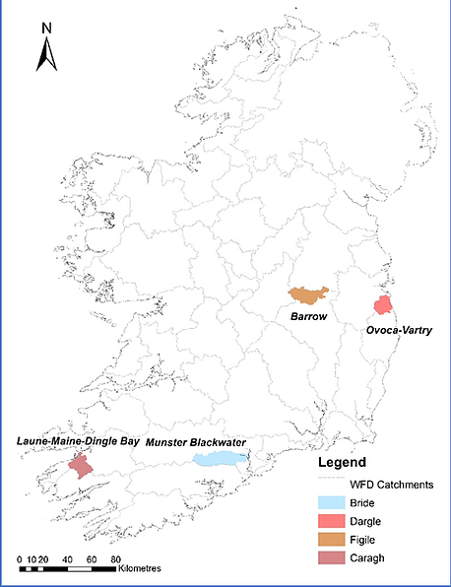
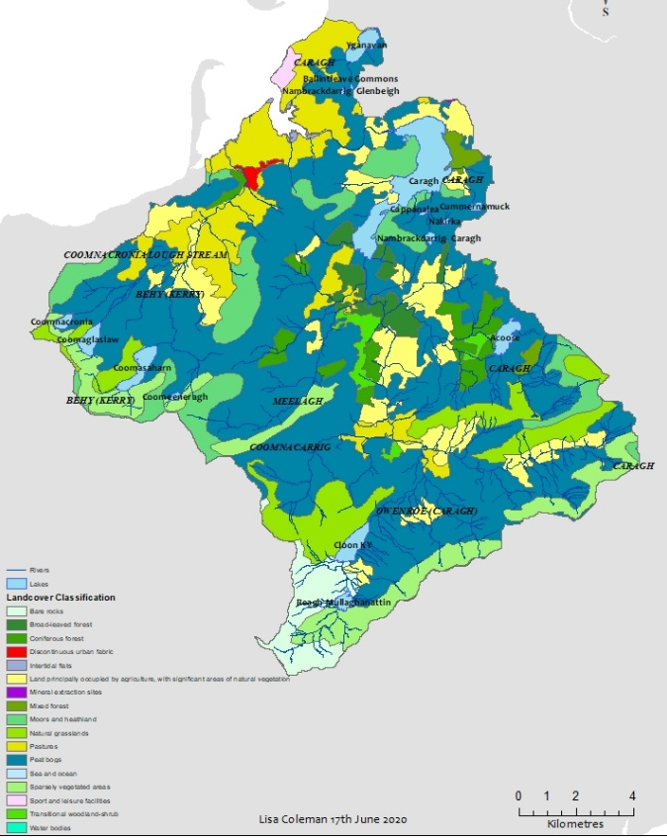
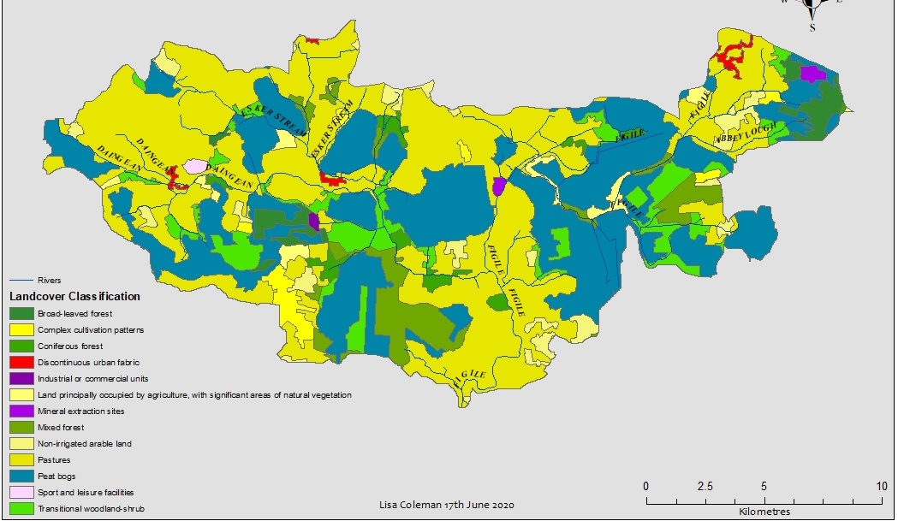
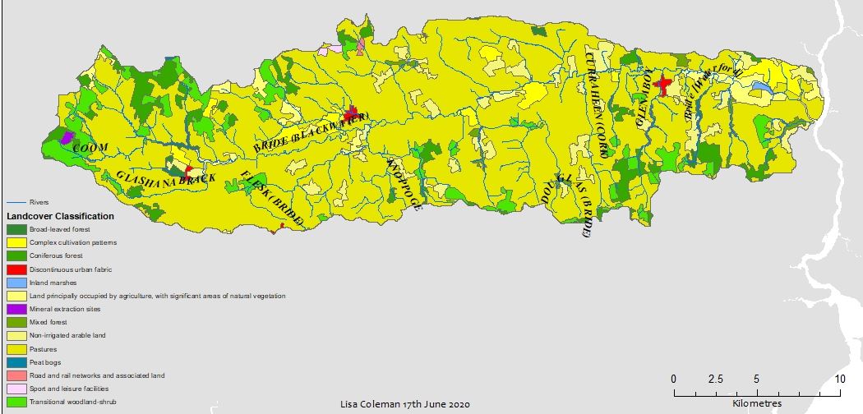
Corine 2012 & 2018
Dargle
Caragh
Figile
Bride

Slide 4
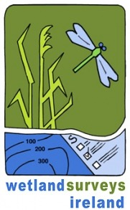
Agencies

Slide 5
Challenges
Finding the Data

Slide 6
Challenges
Finding the Data
Coverage

Slide 7
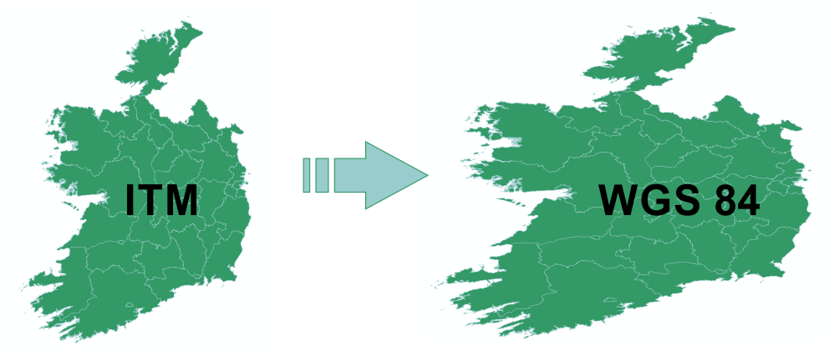
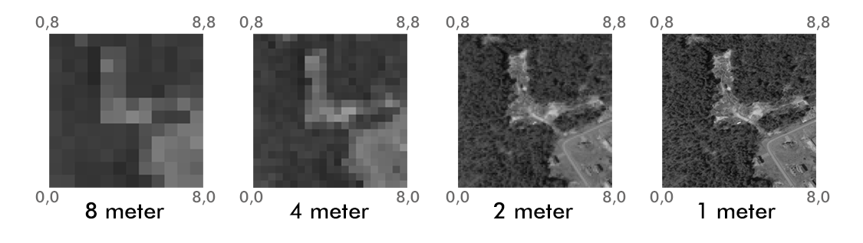
Challenges
Finding the Data
Coverage
Resolution and Coordinates

Slide 8
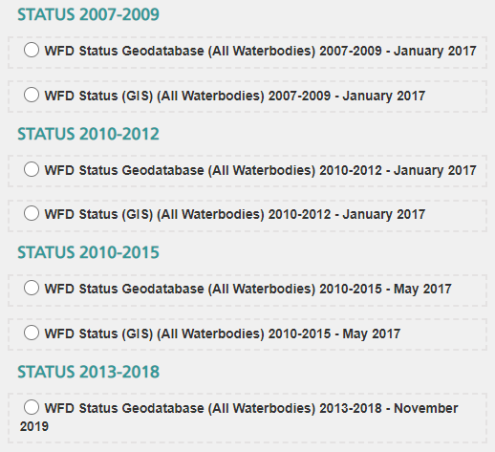
Challenges
Finding the Data
Coverage
Resolution and Coordinates
Time Series

Slide 9
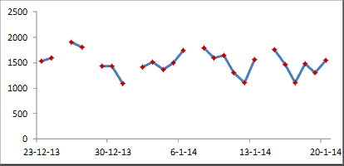
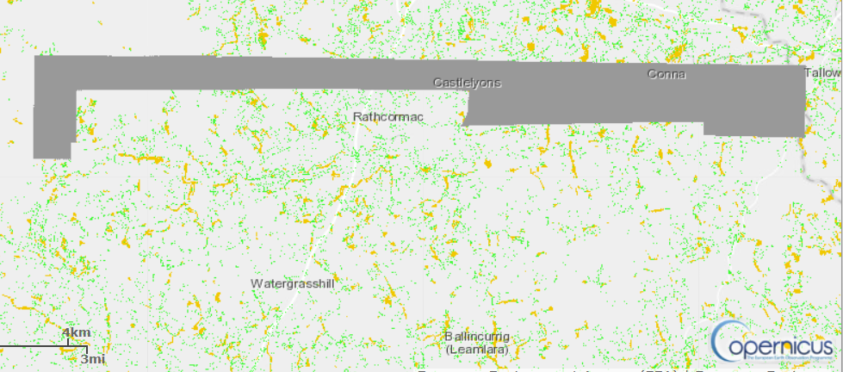
Challenges
Finding the Data
Coverage
Resolution and Coordinates
Time Series
Data Gaps

Slide 10
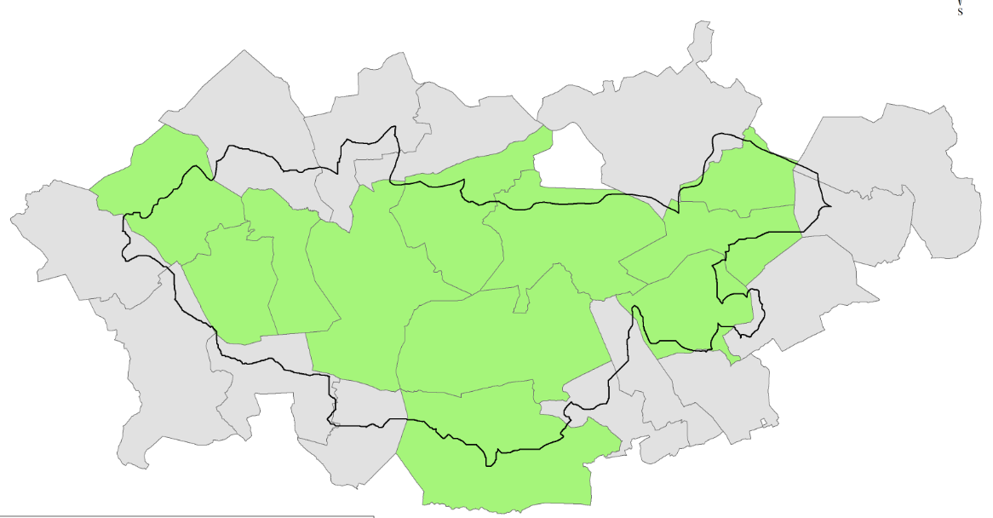
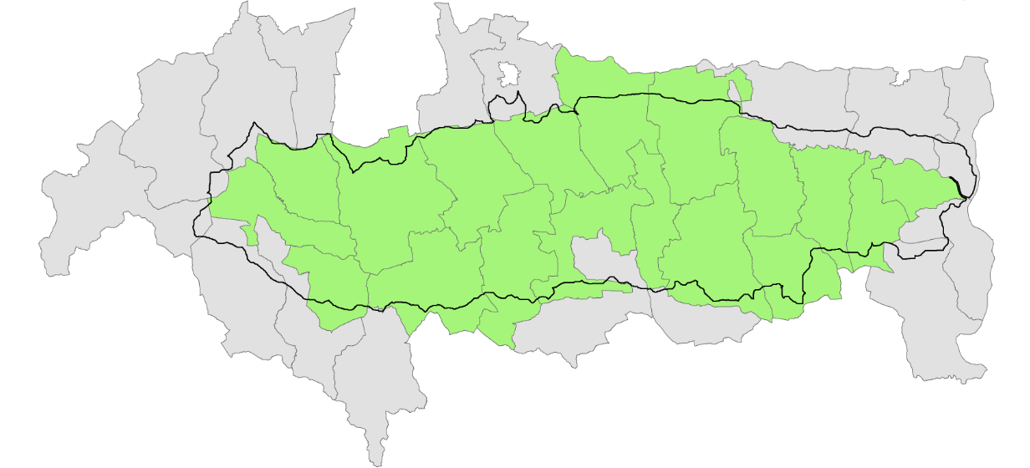
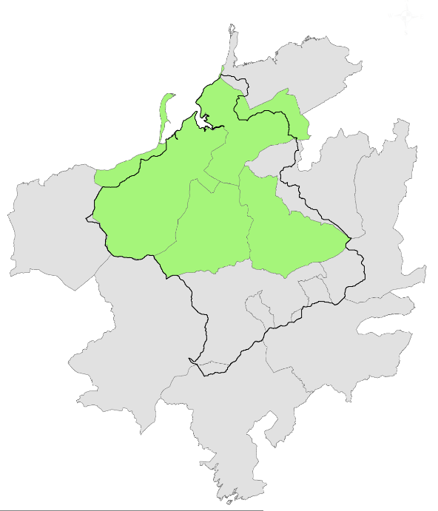
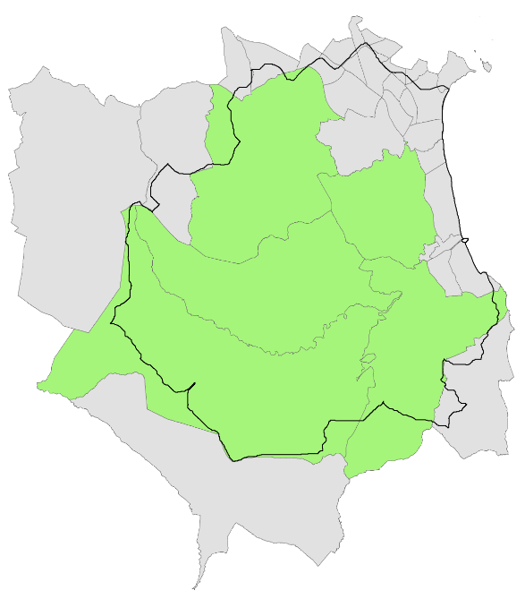
Challenges
Finding the Data
Coverage
Resolution and Coordinates
Time Series
Data Gaps
Catchments

Slide 11
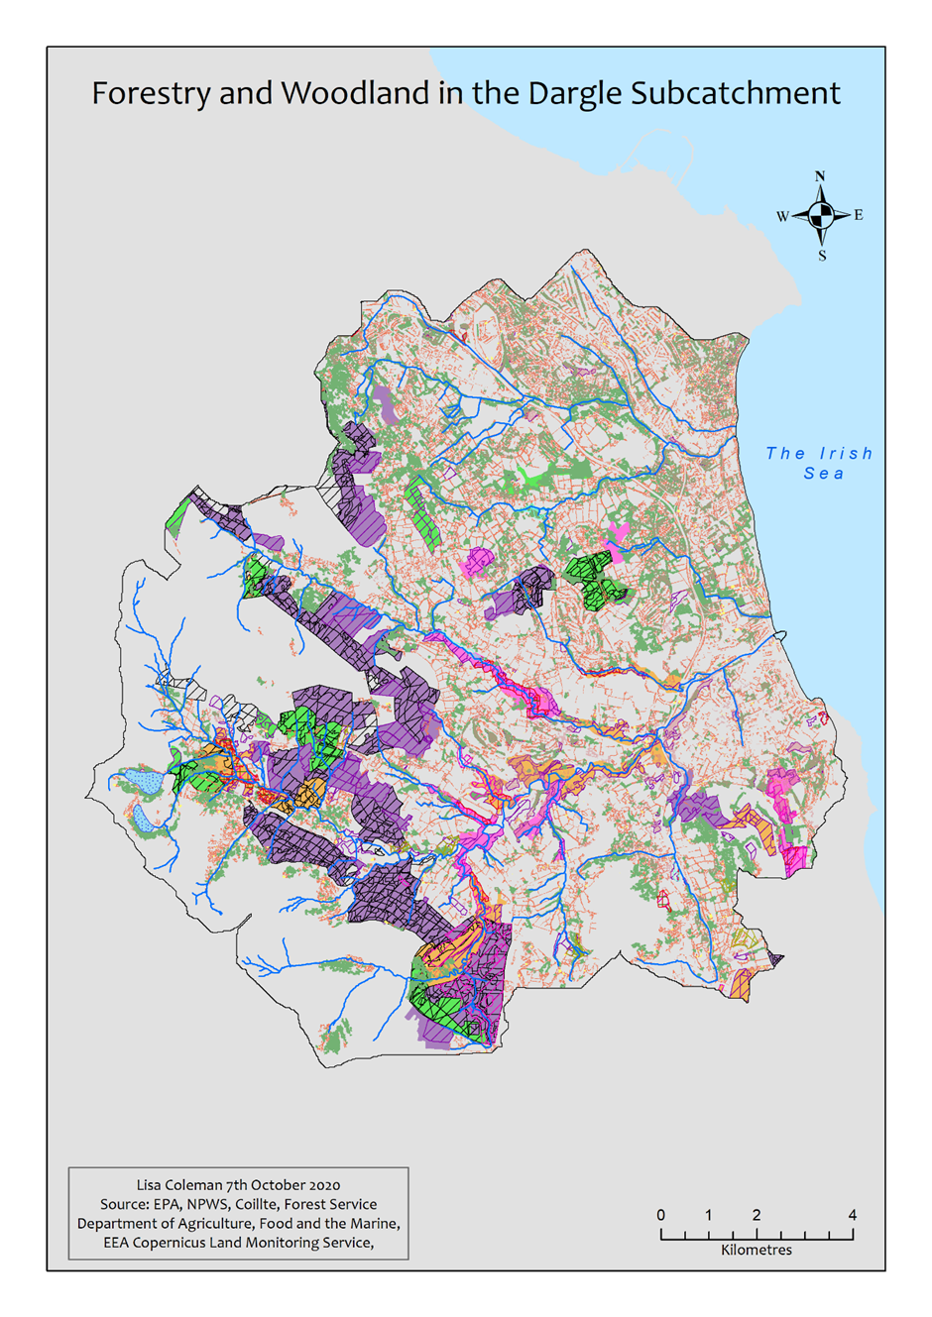
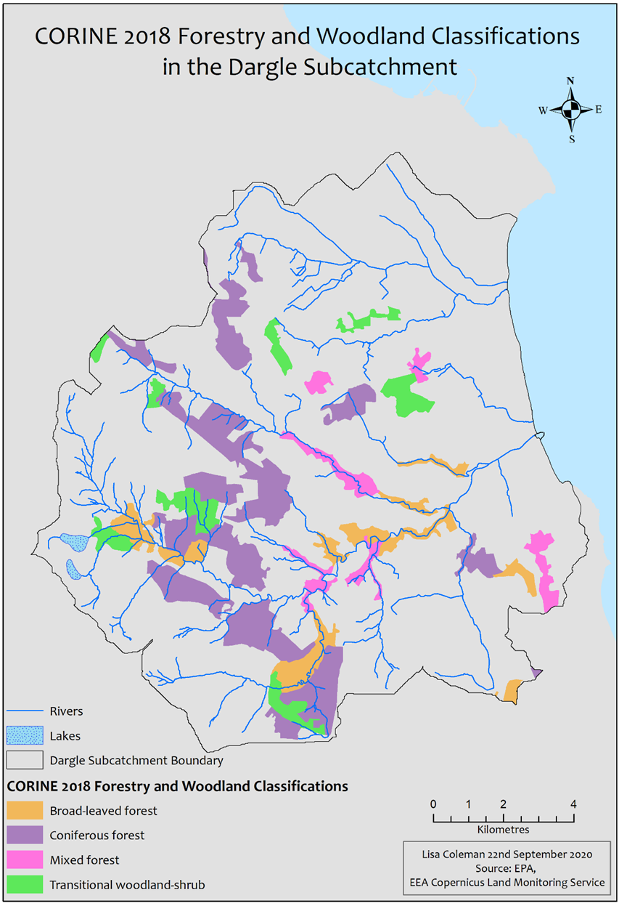
CORINE (all) |  | 3,268 ha 18%
Woodlands (All: ALEW, NSNW, A17, SWF, Street Trees) | 4,694 ha
Forests (ArcGIS)) | 3,245 ha
Total Woodlands and Forests |  | 7,194 ha >40%

