Slide 1
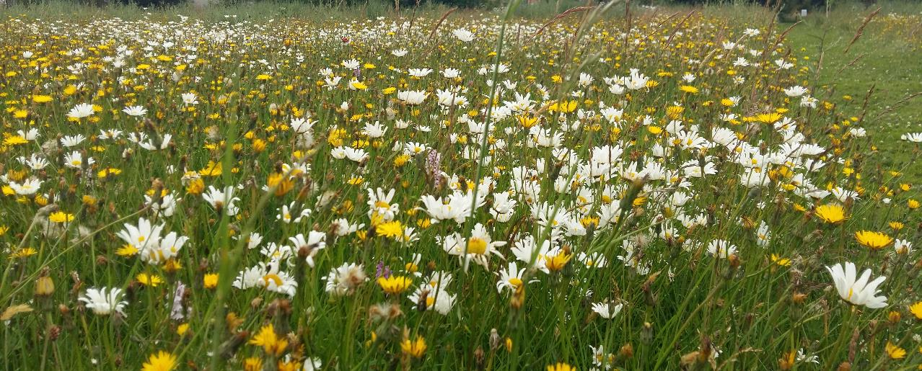

Jane Stout
Professor of Ecology, VP Biodiversity and Climate Action
Natural Capital Stakeholder Workshop
11th June 2025
Department of Climate, Energy & the Environment

Slide 2









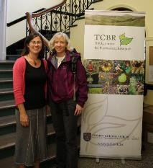



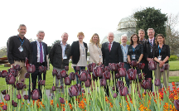


My natural capital journey…
2024
2021
2019
2016
2014
2020
2023
2018
2016
2012
iCLIC: The Irish Climate & Natural Capital Innovation Centre (iCLIC)
https://www.naturalcapitalireland.com/resources

Slide 3

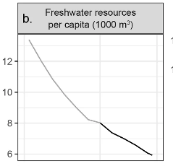
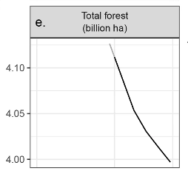
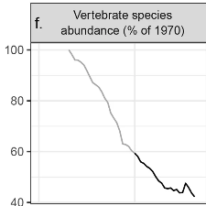



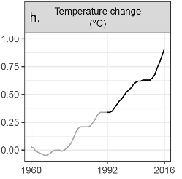
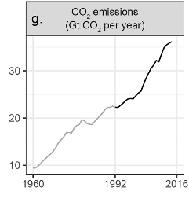
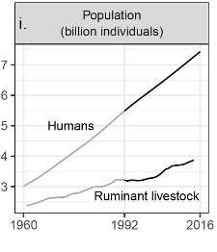




Scientists’ warning to humanity
A second notice
Ripple et al. 2017

Slide 4
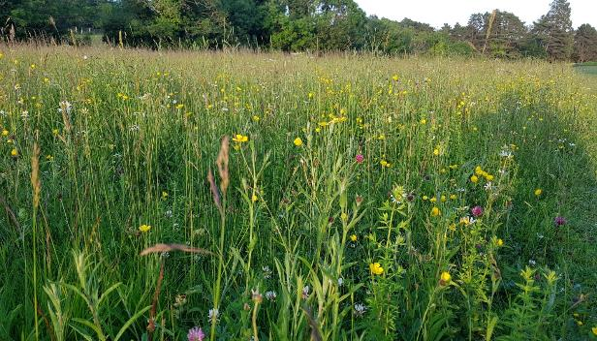
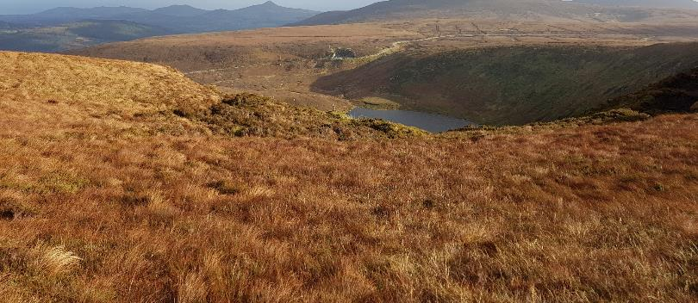




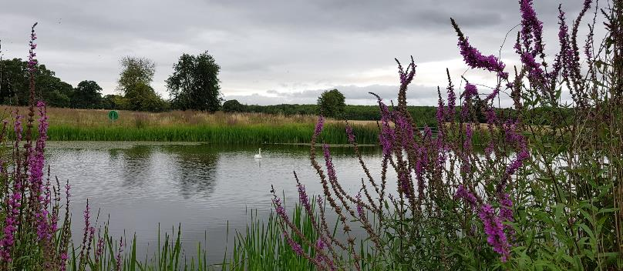
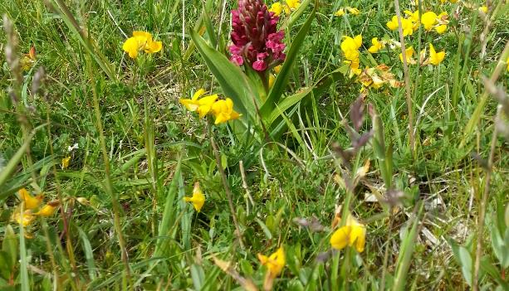




Biomass
Marketable products/ goods
How do we measure changes in natural capital over time?
FLOWS
Ecosystems, geosystems, atmospheric systems
“nature”
Economic activity & wellbeing
STOCKS
Ecosystem functions, species interactions
Non-marketed services

Slide 5
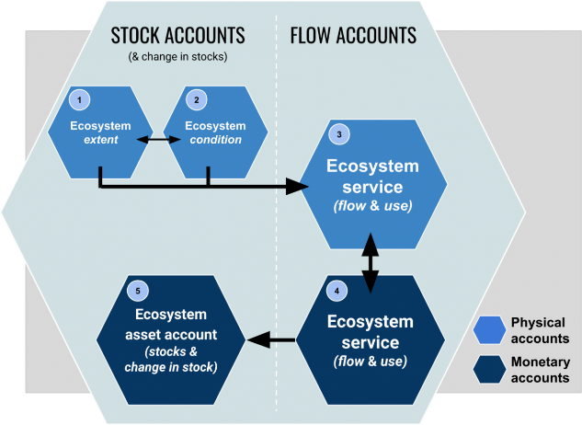


Natural Capital Accounting
Ecosystem Accounting, 2021
2019

Slide 6

“narrow set of market values of nature have led to the global biodiversity crisis”
2022

Slide 7



Ecosystem Accounting
Ecosystem Extent
Ecosystem Condition
Ecosystem Services
Dairy farms
Wind farms
Forestry

Slide 8
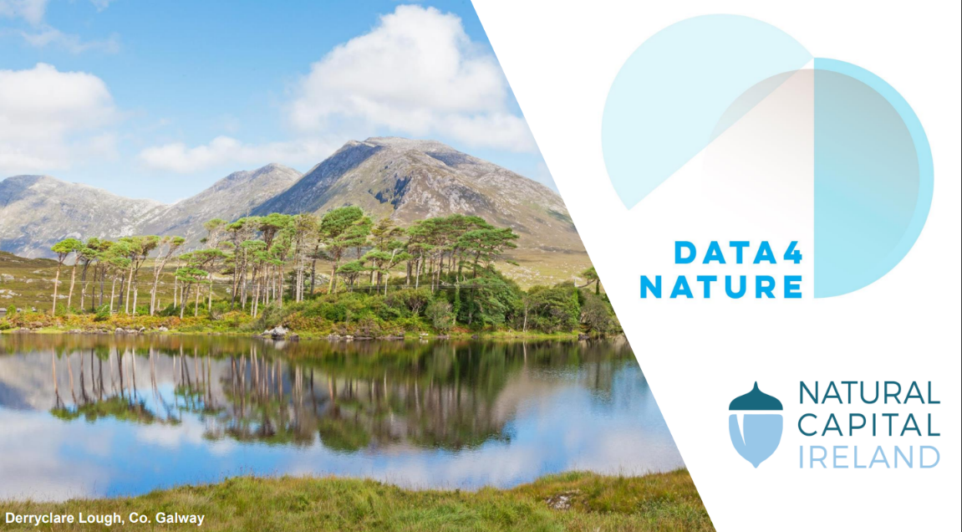
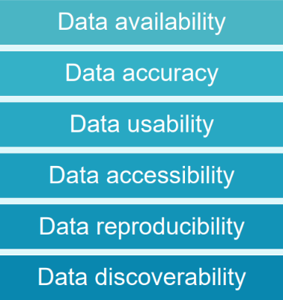
www.naturalcapitalireland.com

Slide 9


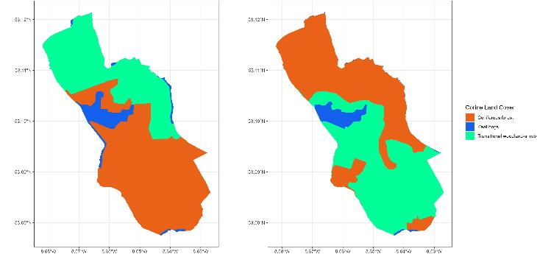
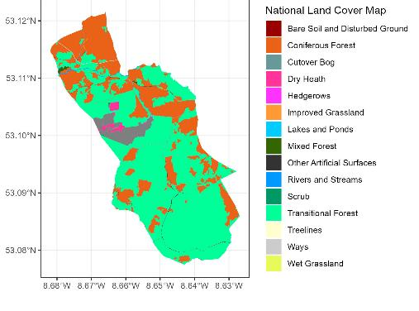
Extent Accounts
Francesco Martini
Kathleen Conroy
CORINE (MMU 30ha)
National Land Cover Map (MMU 0.1ha)
2012
2018
2018
Lower resolution, fewer land cover types
One time point

Slide 10


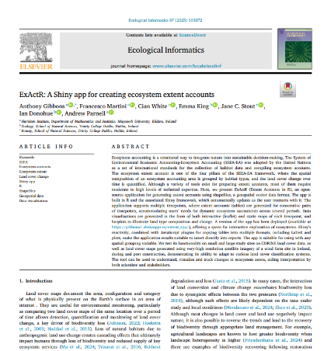

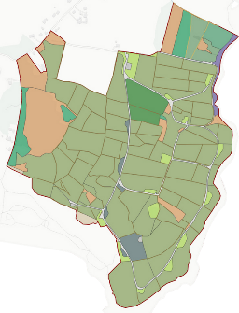
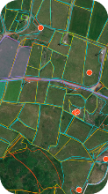
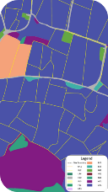
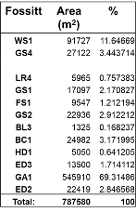
Extent Accounts
Emma King
Anthony Gibbons
Requires field assessment of site

Slide 11




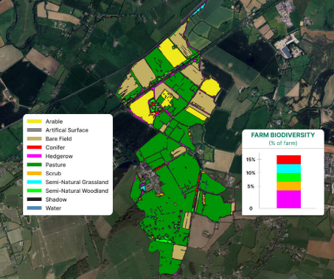

Extent Accounts
Alejandro Vergara
Cian White
Specific remote assessment services required
Notes:
As part of the FarmZero C project, Cian developed a remote technique using satellite imagery at farm scale, to determine landcover, and is now working in a spin out ODOS to provide this service to farmers for quantifying both carbon budgets and on-farm biodiversity – this enables farmers to avail of sustainability incentives from processors, and to transparently report on their farm status.

Slide 12
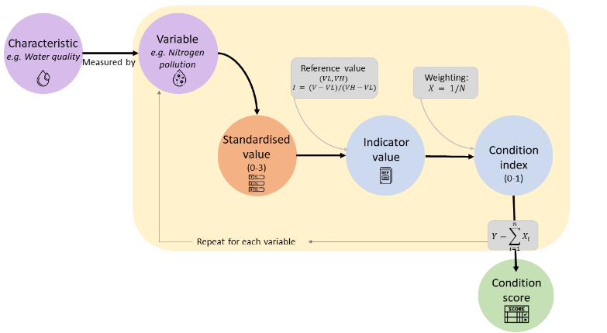
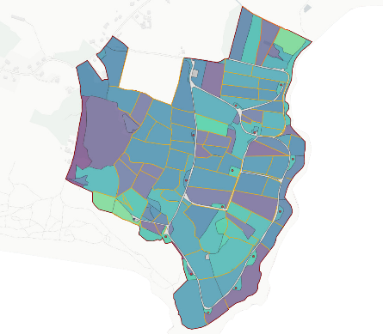
Condition Accounts
Emma King

Slide 13
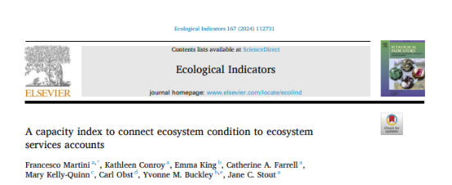

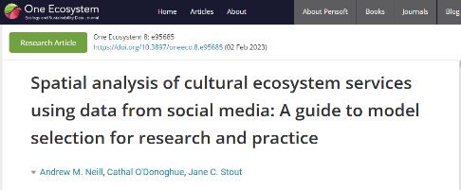

Ecosystem Services
Biodiversity
Grass biomass provisioning
Climate regulation
Biodiversity
Cultural services
Wood provisioning
Climate regulation
Biodiversity
Cultural services

Slide 14
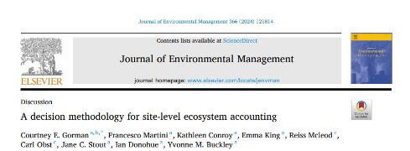
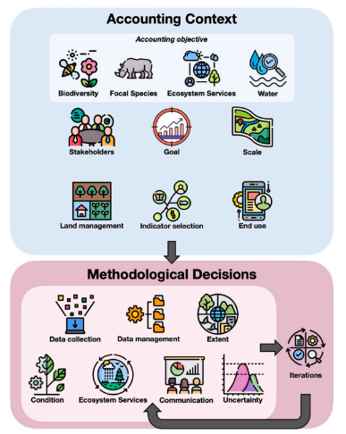
Learnings from site scale
High resolution base map is essential for site-scale Ecosystem Accounts
These must be updated regularly to provide time series
Ecosystem service data required (esp. for biodiversity and cultural services)
Tools and technology can help
Site-level accounts are context specific (it depends on what you want to use them for!)

Slide 15
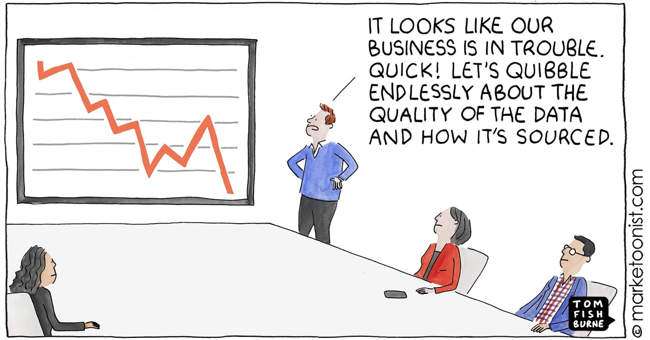
PLANET
Challenges:
Extent: Data at site scale over time
Condition: Calculating condition indicies
Ecosystem Services: Data scarcity esp. cultural services
Scale at which decisions are made

