Slide 1
Biodiversity data infrastructure –
National Biodiversity Data Centre
Tuesday, 11th May, 2021
Dr. Liam Lysaght
Centre Director

Slide 2
Sectoral assessment at outset
Inability to answer basic questions:
What biodiversity do we have?
How is it distributed?
How is it changing?
Needs for availability of data not met
Reasons:
No centralised system for management of Ireland’s biodiversity data
Data was dispersed across various individuals, projects and organisations
No common standards, tools or ways to share data
Context:
Many organisations, but no data sharing or coordination agreements
No dedicated voice to promote biodiversity data
No clear infrastructure for coordination and collation of biodiversity data

Slide 3
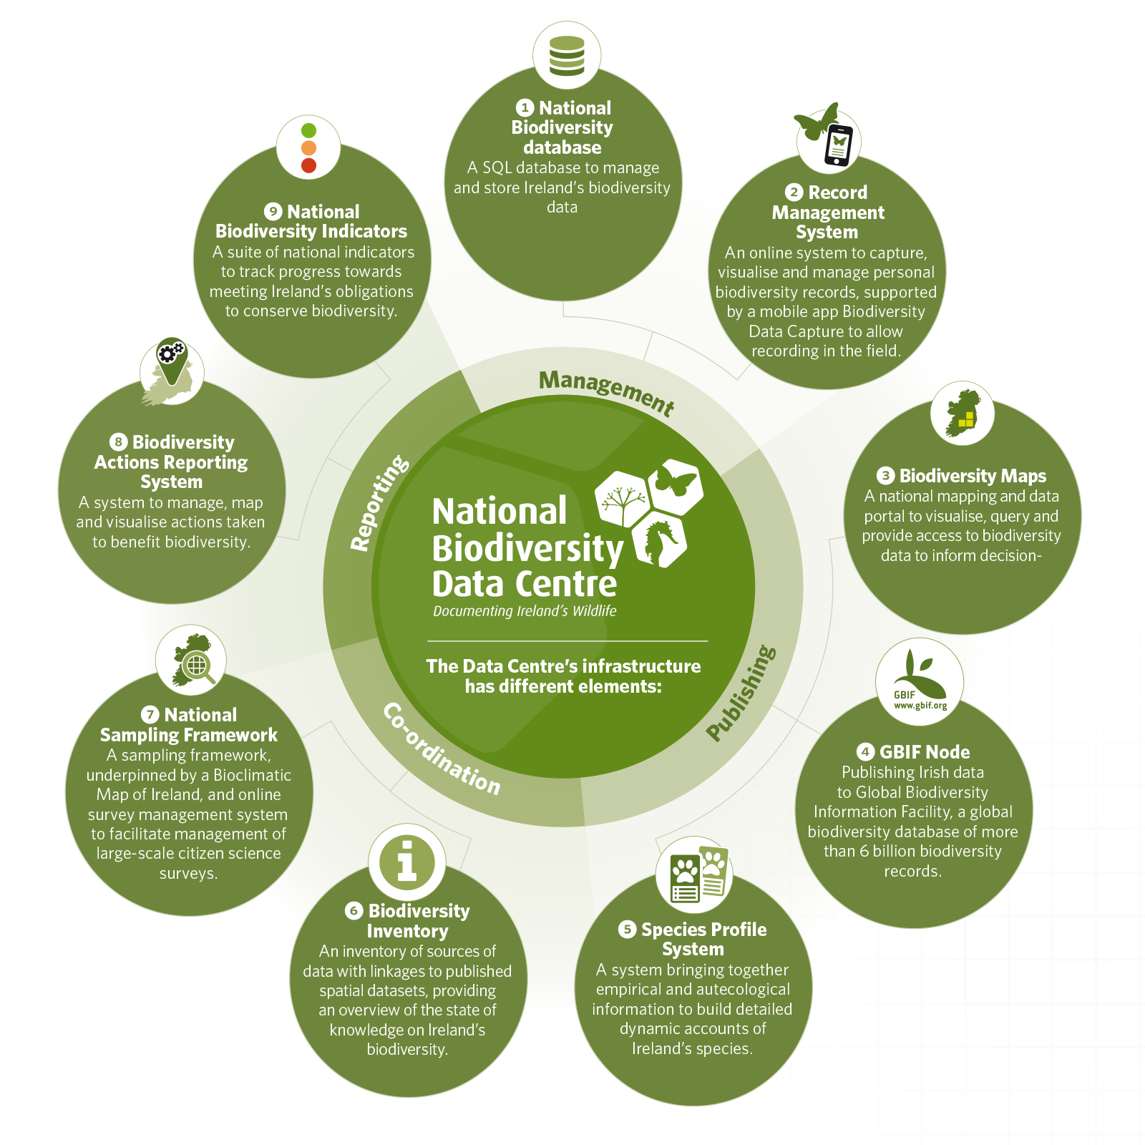
Bioinformatics Infrastructure
Seven objectives of our Strategic Plan:
Mobilise data
Track change
Inform decision making
Develop strategic partnerships
International collaboration
Communicating the value of biodiversity
Strengthen the recording base

Slide 4
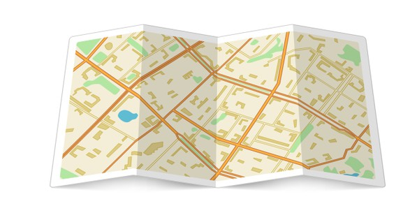
Bioinformatics Infrastructure: Biodiversity Maps

Slide 5
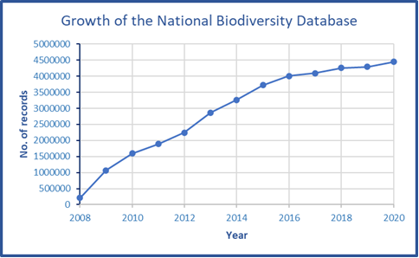
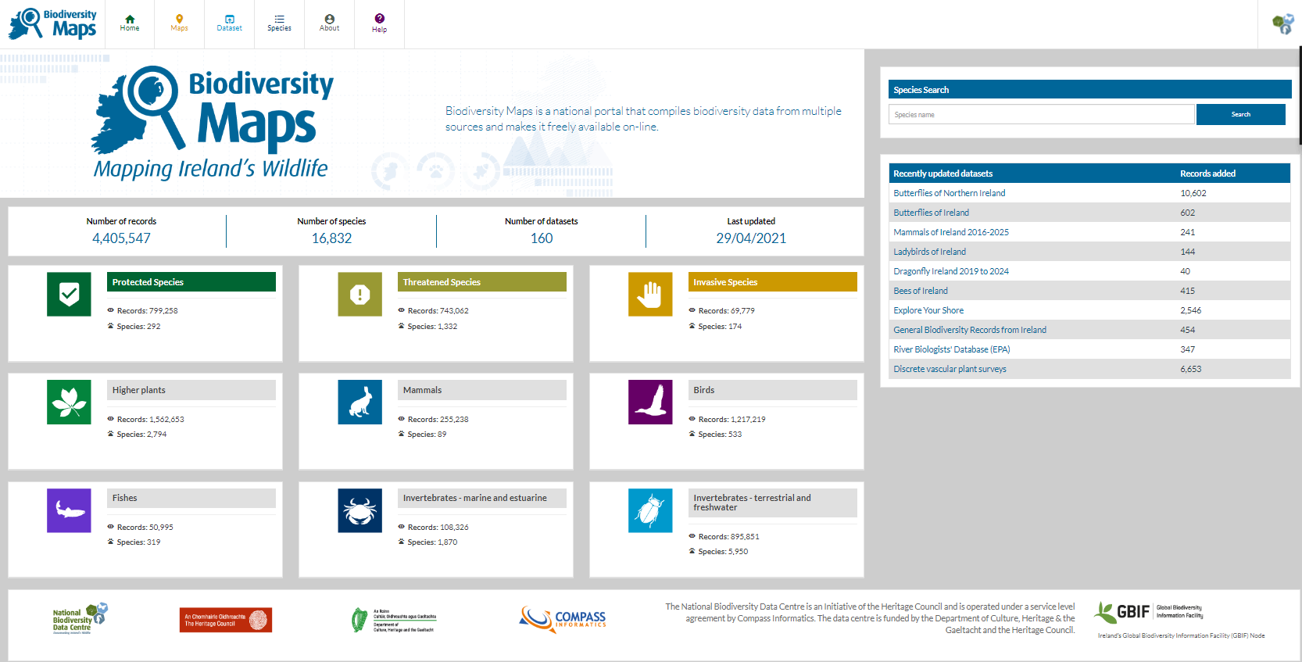
Status at end 2020
4,405,547 occurrences
[1,111,385 open data (CC-BY)]
16,832 species
160 datasets

Slide 6
Uses and users of this shared-service
State bodies
Research Community
NPWS
EPA
Dept. of Agriculture, Food & Marine
Inland Fisheries Ireland
National Museum of Ireland
National Botanic Gardens
Sea-Fisheries Protection Authority
Trinity College
University College Dublin
NUI Galway
Irish Biogeographical Society
CreBeo Earthworm dataset
BioMar Marine Survey
ObServe Acoustic Surveys for Cetaceans
NGOs
British-based organisations
Bat Conservation Ireland
Irish Whale and Dolphin Group
Birdwatch Ireland
Irish Peatland Conservation Council
Tree Council of Ireland
Irish Federation of Sea Anglers
Botanical Society of Britain & Ireland
British Bryological Society
British Mycological Society
Balfour Browne Club
Joint Nature Conservation Committee
UK Biological Records Centre

Slide 7
Biodiversity data infrastructure
The vision:
National platform for digital biodiversity data management
Dedicated data curation services
Portal for publishing and dissemination of biodiversity data
Resource for decision-making & research
Common standards & licences, promoting open and reuse of data
State investment – predicated on principle of being offered as shared service to partners to deliver added value
The challenge:
Need to promote benefits of open data
Was initially well funded, but continued investment required
Need consensus around national platform
Has not reached its potential as a national infrastructure to deliver data, in the format required, for decision-making and research purposes.
But:
National Biodiversity Data Centre’s bioinformatics infrastructure is still the best starting point for meeting the data needs to inform biodiversity conservation and its related policy needs.

