Slide 1
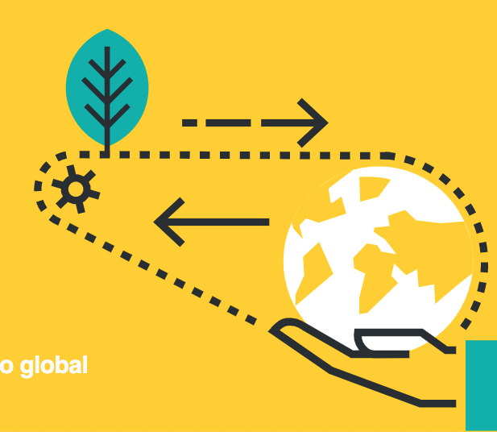
Optimising data for maximum use
Yvonne Buckley
@y_buckley
Notes:
10 mins
Data workflows – optimising data delivery at the start of the pipeline so it can be put together and re-used in many ways. I have lots of experience in using other people’s data and making sure that the data products we derive from freely available data are reproducible and add value and that these derived data-sets are in turn made available in usable ways. On this theme there are a couple of sub-themes: the intensive nature of data collection in ecology, sometimes hours/days/months/years of observation or experimentation go into the collection of relatively few data points. How do we ensure that the full value of these intensive data are available to be used beyond the lifetime of that project? – are there ways in which we could collect data that would make collation and comparability between projects possible/easier? “Team science”, the collection of data by many scientists, often globally, that is used to answer a particular question/hypothesis. Are there structures that incentivise collaborative data collection and analysis?

Slide 2
Accuracy
Availability
Accessibility
Usability
Reproducibility
Discoverability
0111000010100100011100001
Think about RE-USE from the start!
Notes:
Data are often:
Expensive to collect (time, resources, people)
Unique
Context dependent
Part of a complex system of dependencies
Future you will be pleased!

Slide 3
Distributed data collection
Targeted initial questions & untargeted reuse
Multiple data users
Data compilation from multiple sources
Data curation
Data availability
COMPADRE Plant Matrix Database
COMADRE Animal Matrix Database
Notes:
Team Science – NutNet & Plantpopnet – targeted data collection across tens of researchers, globally distributed
COMADRE & COMPADRE – collation & curation of data from the literature and making it discoverable, available

Slide 4
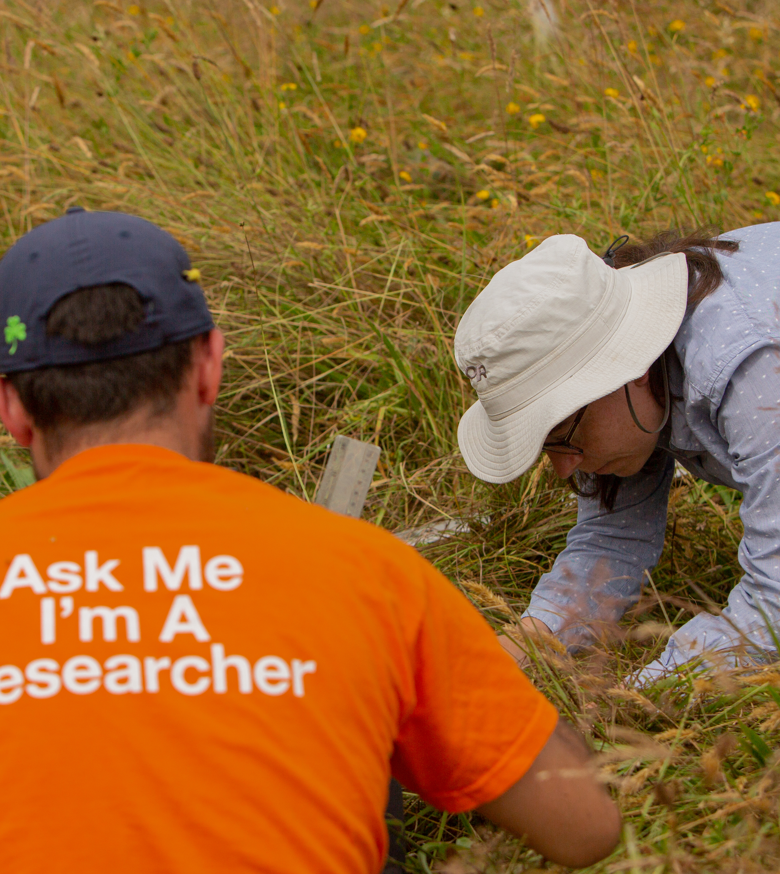
Data collection
Clear collection protocols – pilot with different people & be prepared for misinterpretation ACCURACY
Contextual information is critical - GPS coordinates enable more data to be appended, or surveys repeated USABILITY, REPRODUCIBILITY
Think about data-sheet/database design for how data will be collected and how it will be organized for curation, storage, analysis ACCESSIBILITY, USABILITY

Slide 5
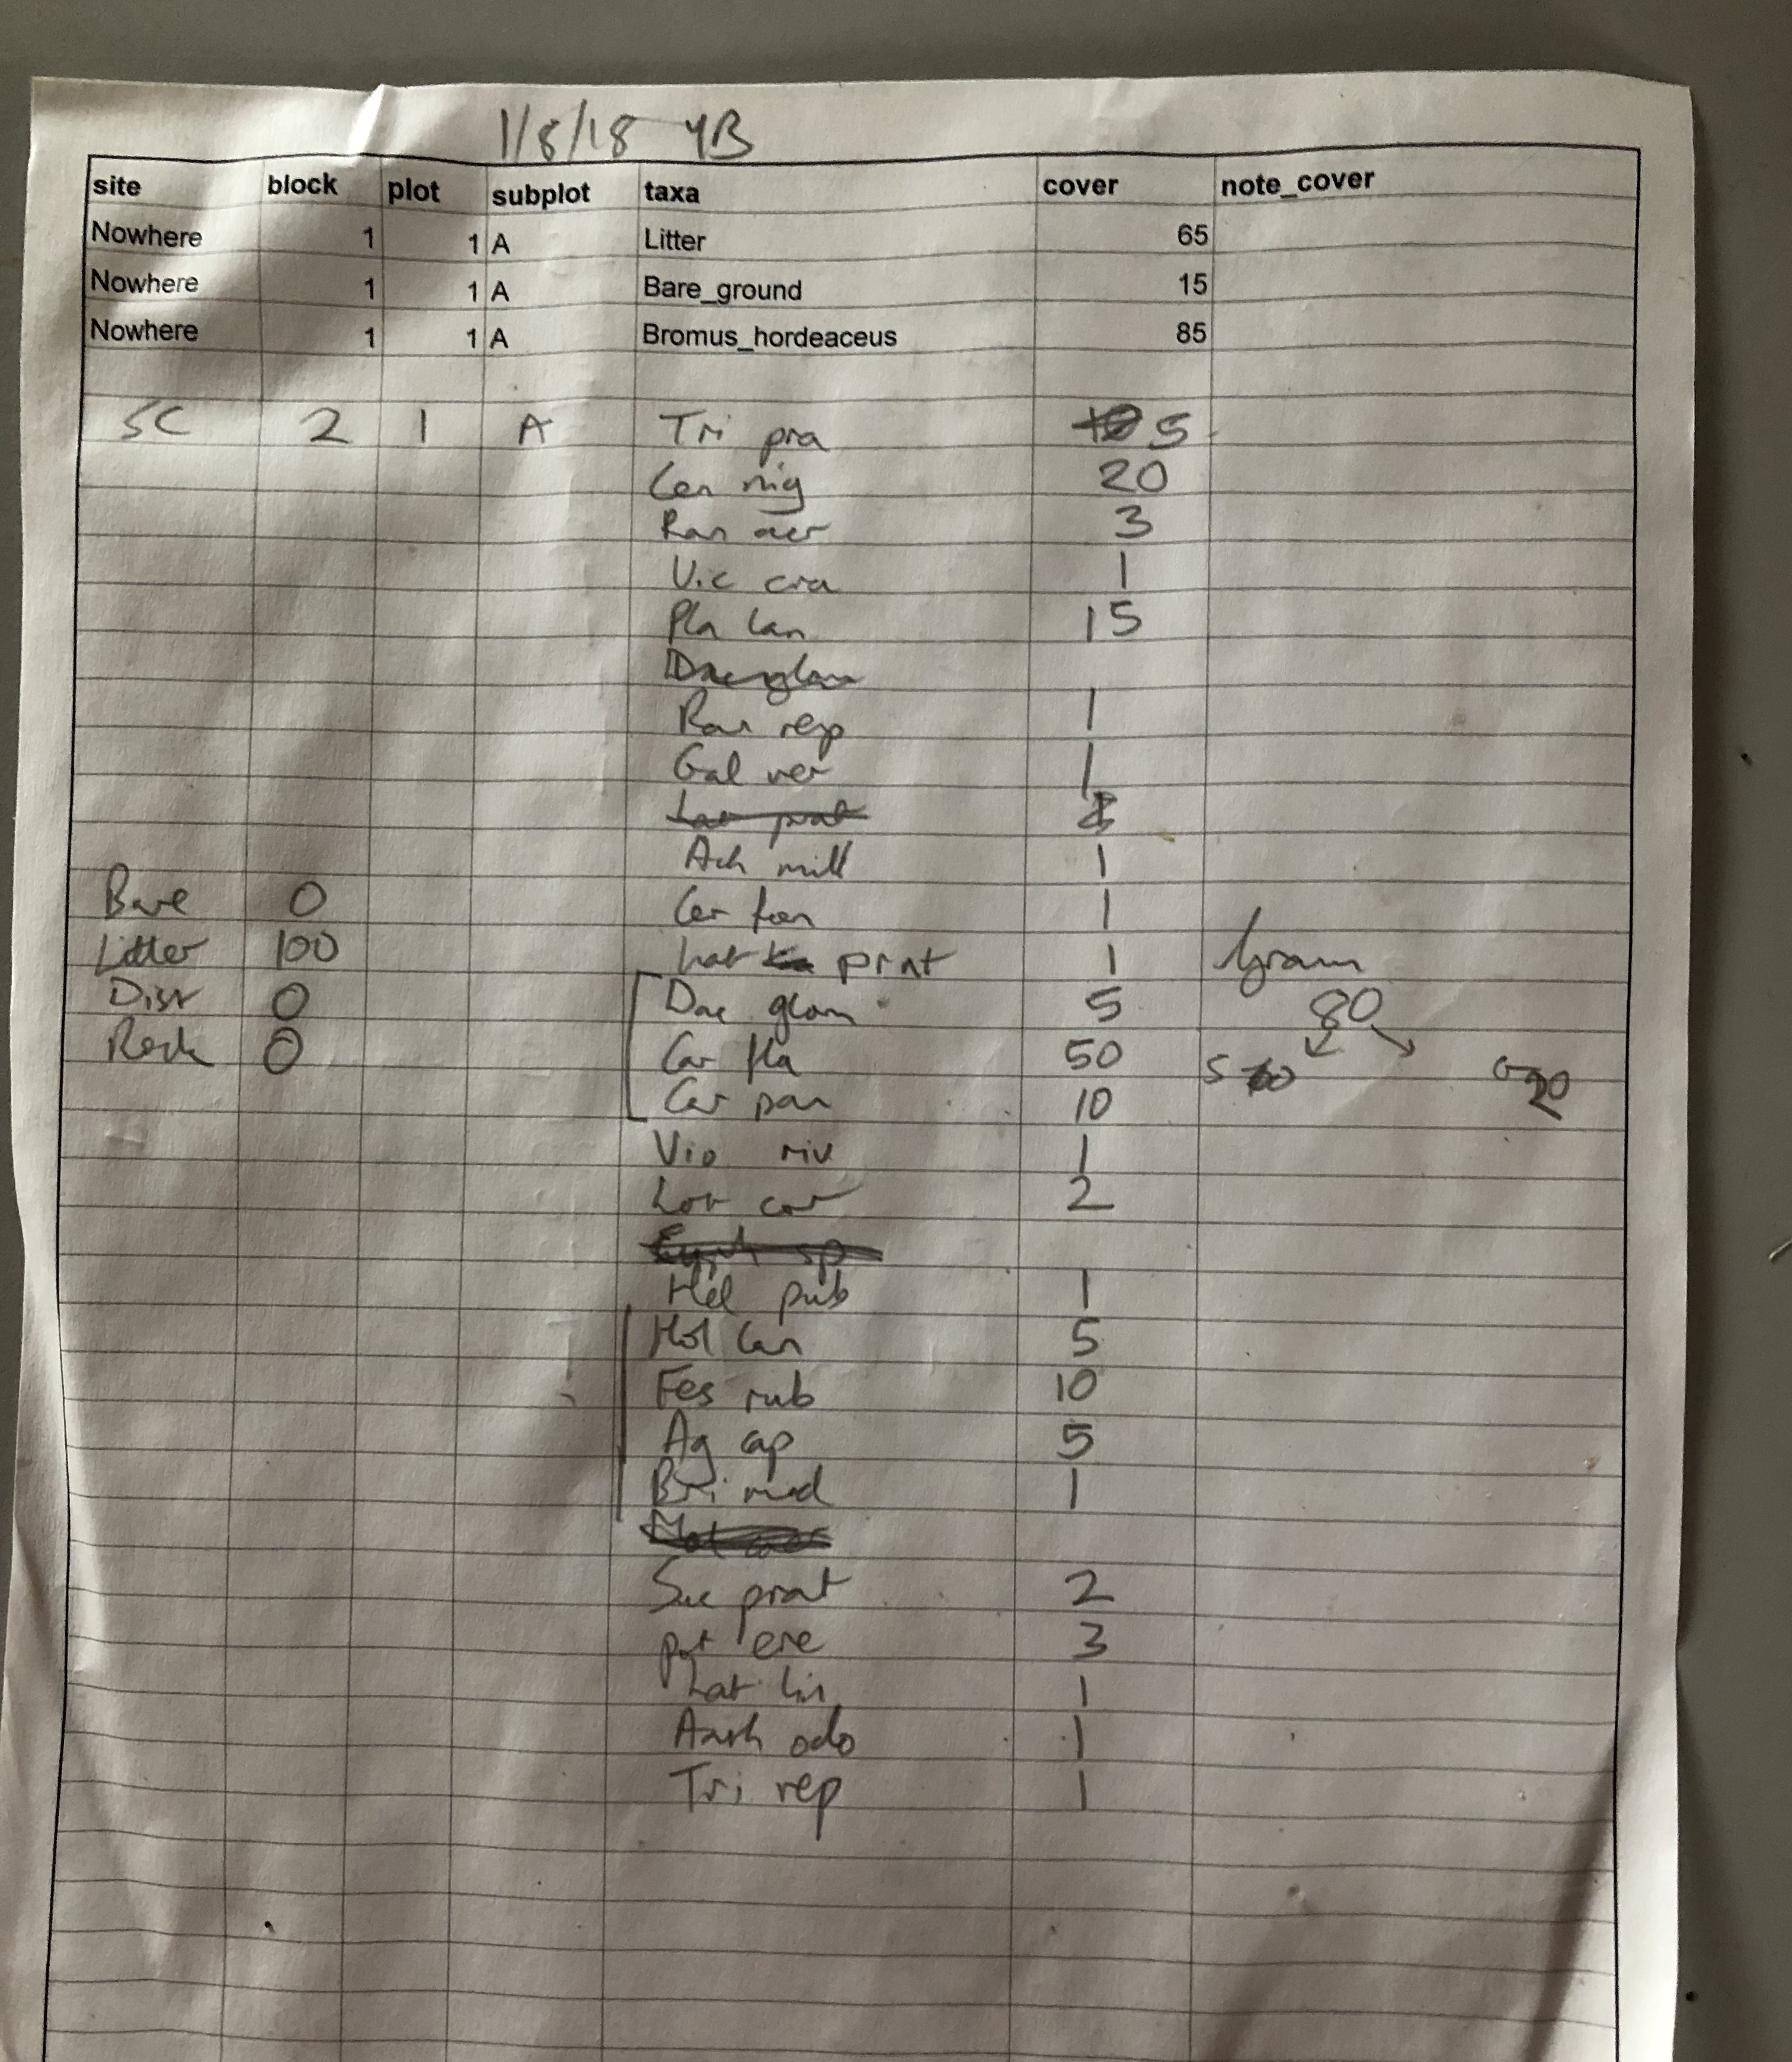
Data Management
Have a Data Management Plan from day 1, it can always be amended/improved
Data sharing agreements/policies are important, attribution, authorship, responsibility DISCOVERABILITY, ACCESSIBILITY
This is a real job it needs to be recognized and rewarded

Slide 6
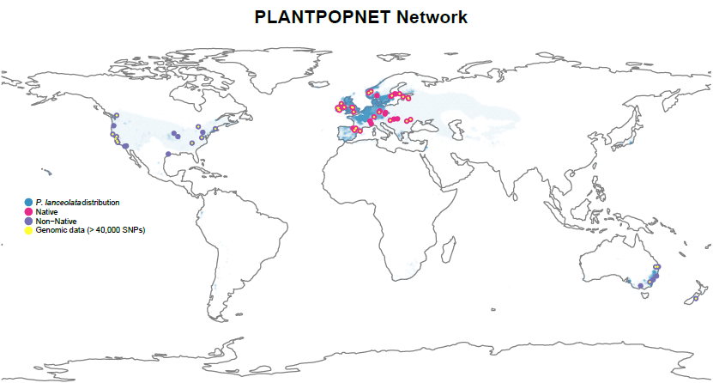
Function | Total person years
Coordination of network | 0.35
Steering Group contributions | 0.9
Data collection | 2.8
Data curation | 3.9
2014 - 2021

Slide 7
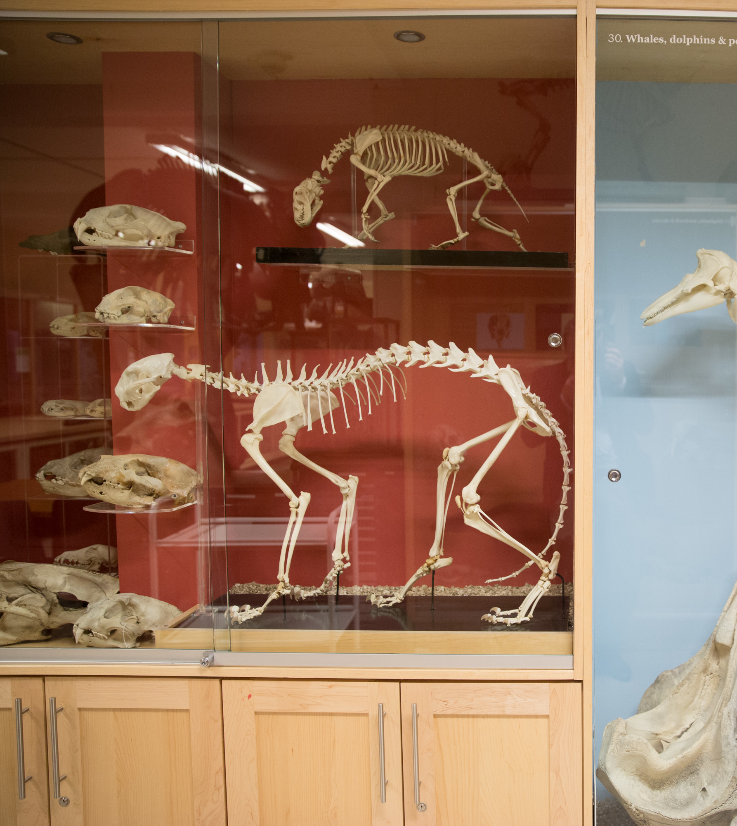
Data curation
Use interoperable formats, reusable formats USABILITY
Document and automate data cleaning & repair REPRODUCIBILITY, ACCURACY
Produce Standard Data Products USABILITY, ACCURACY
Plan for versioning ACCURACY

Slide 8
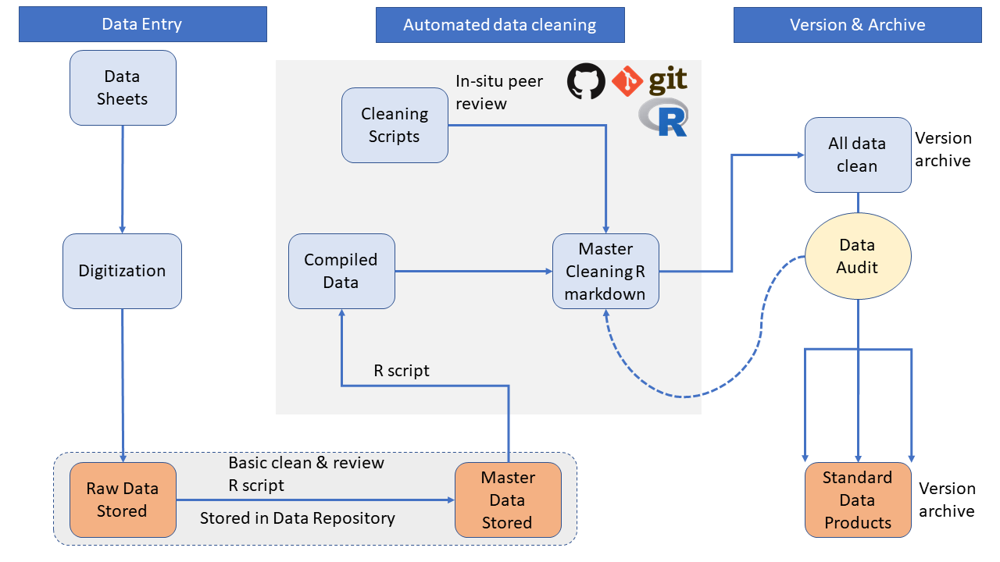

Slide 9
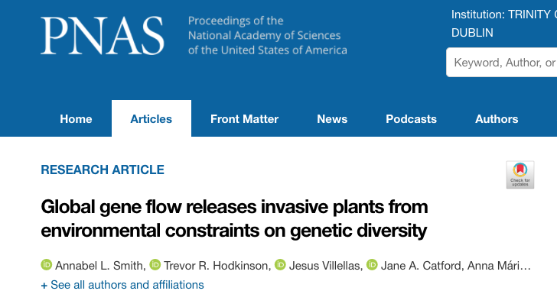
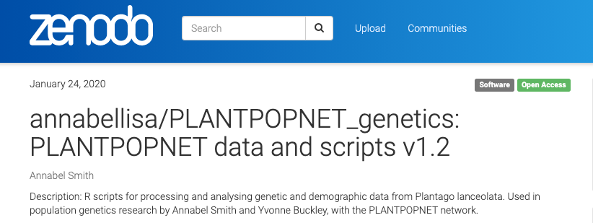
Output production & management
Make data sharing happen
Make data discoverable
Meta-data
Where to archive
doi
Reward the work
Cite data objects
Budget appropriately for data work
Tracking use and reuse
Demonstrate the value of sharing
Notes:
Licenses are important

Slide 10
What would a national Biodiversity Data Observatory look like?
Bring together all national biodiversity data
Citizen Science
Habitats Directives monitoring
EIA and AA data
Incentivise use with targeted funding – synthetic workshops, collaborative analyses nationally, Europe & globally
Produce synthetic data products
Integration of remote sensing and ground collected biodiversity data
Mandate to make data available & usable
Link with Long Term Ecosystem Research sites - ILTER & eLTER
National countryside monitoring scheme

Slide 11
Acknowledgements
Australian Research Council
Marie Curie Career Integration Grant
Science Foundation Ireland
Irish Research Council
Alain Finn – Plantpopnet Data manager
Plantpopnet Data Cleaning Team: Alain Finn, Ruth Kelly, Maude Baudraz, Caroline McKeon

