Slide 1
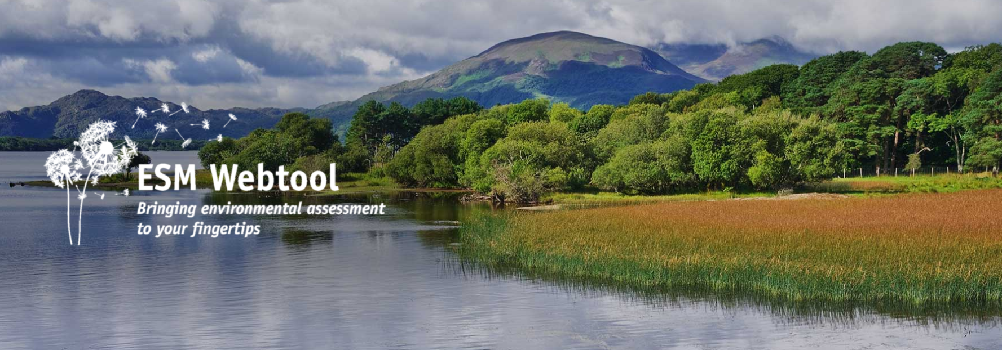
Environmental Sensitivity Mapping
Assoc. Profesor Ainhoa González
Project PI, School of Geography, University College Dublin

Slide 2
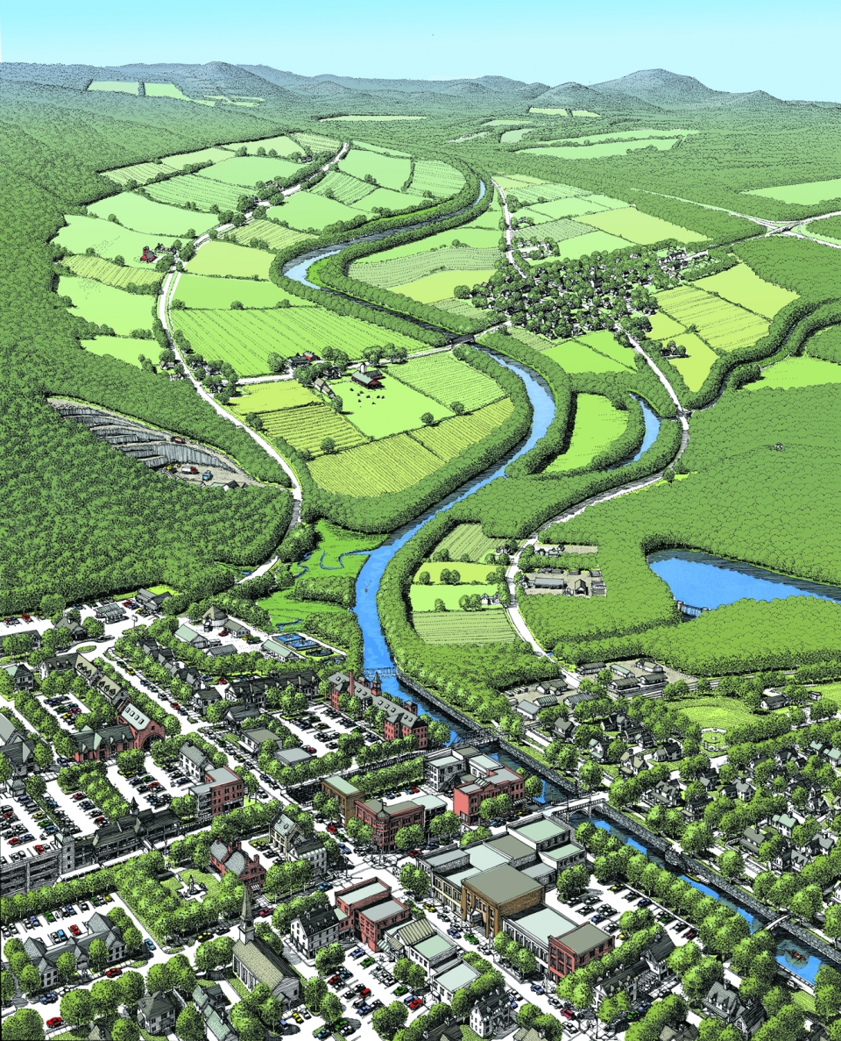
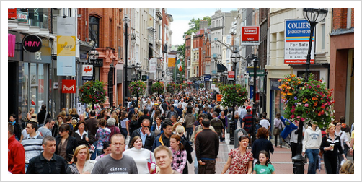
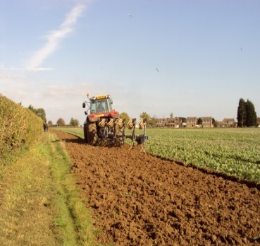
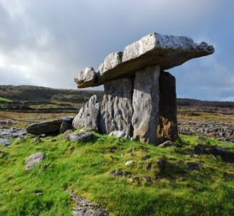
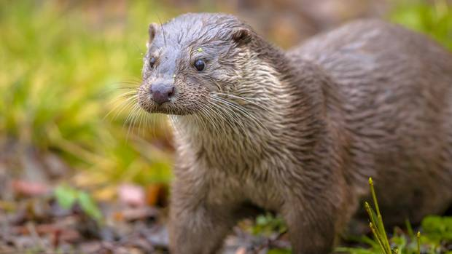
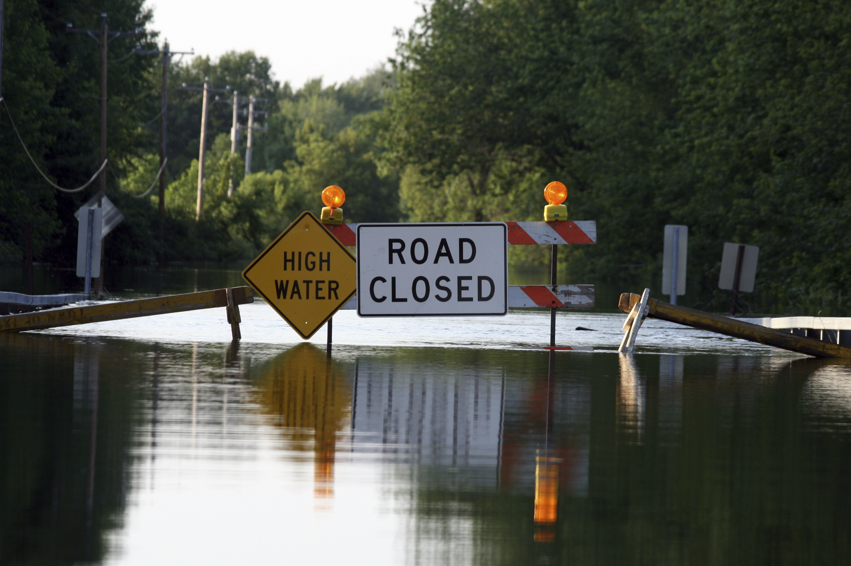
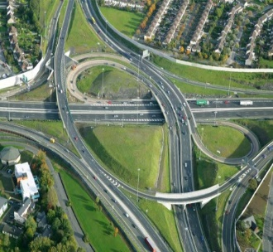
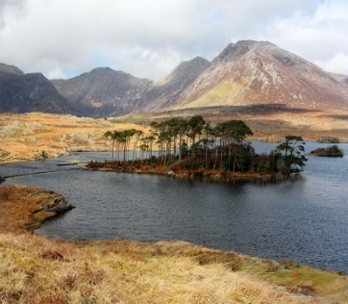
SEA and Spatial Planning
Population and human health
Biodiversity, flora, fauna
Air and climate
Soils and geology
Water
Landscape
Cultural heritage
Material assets
Inter-relationships
Multiple considerations,
spatial implications, consultation
Spatial evidence-base for SEA and planning decisions
Assessment consistency and transparency
Intrinsic environmental conditions > susceptible to change
Early-warning of potential land-use conflicts

Slide 3
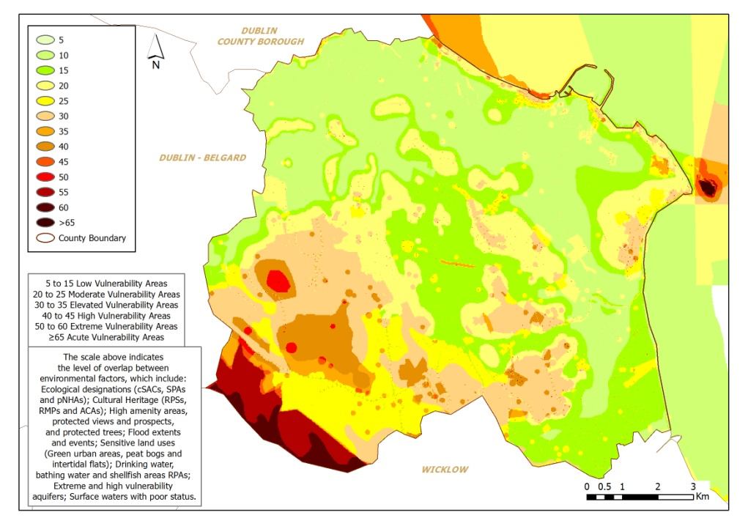
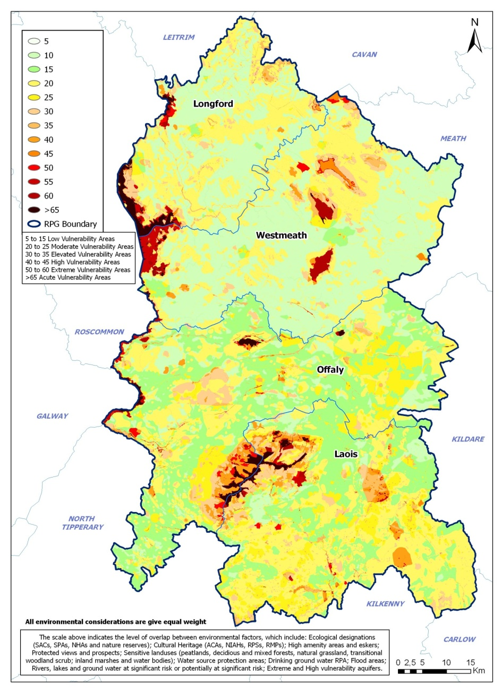
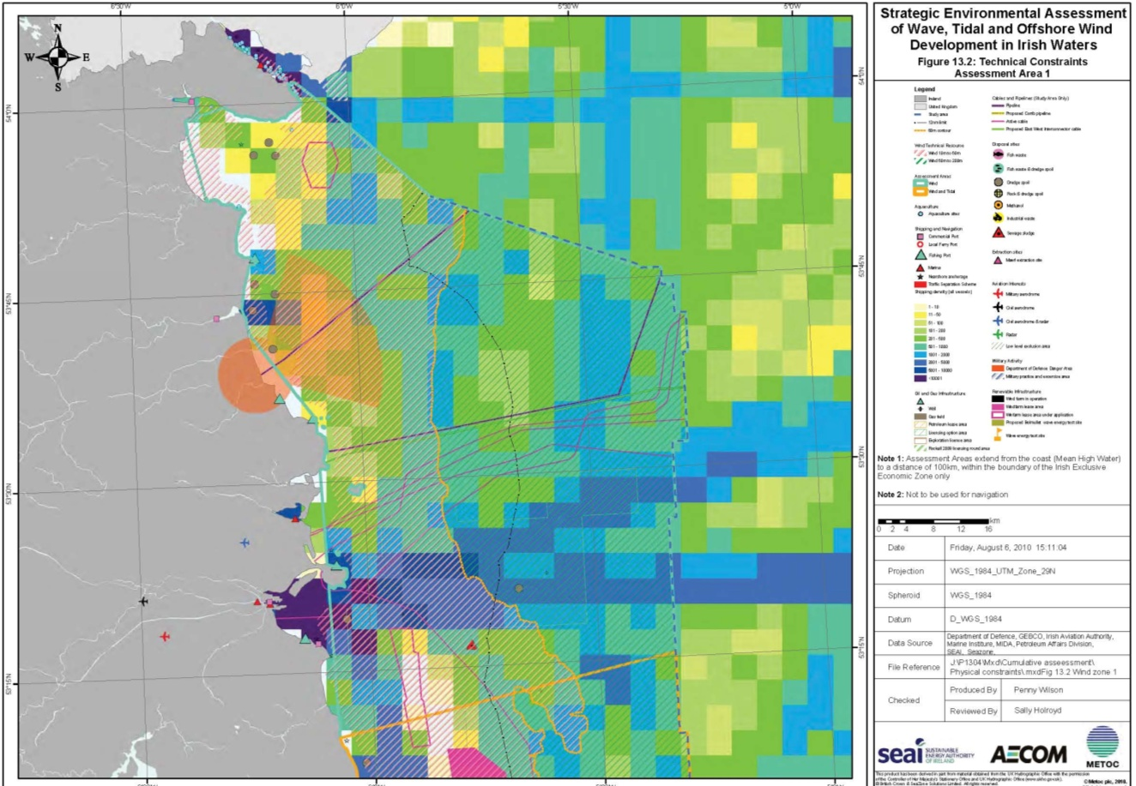
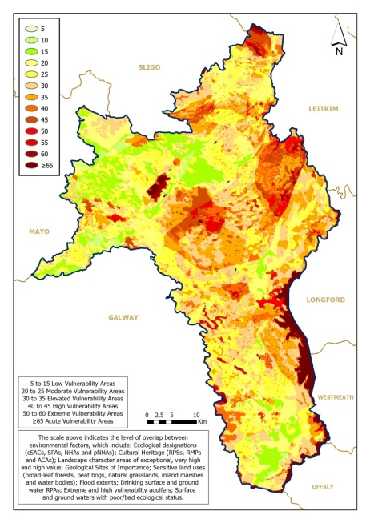
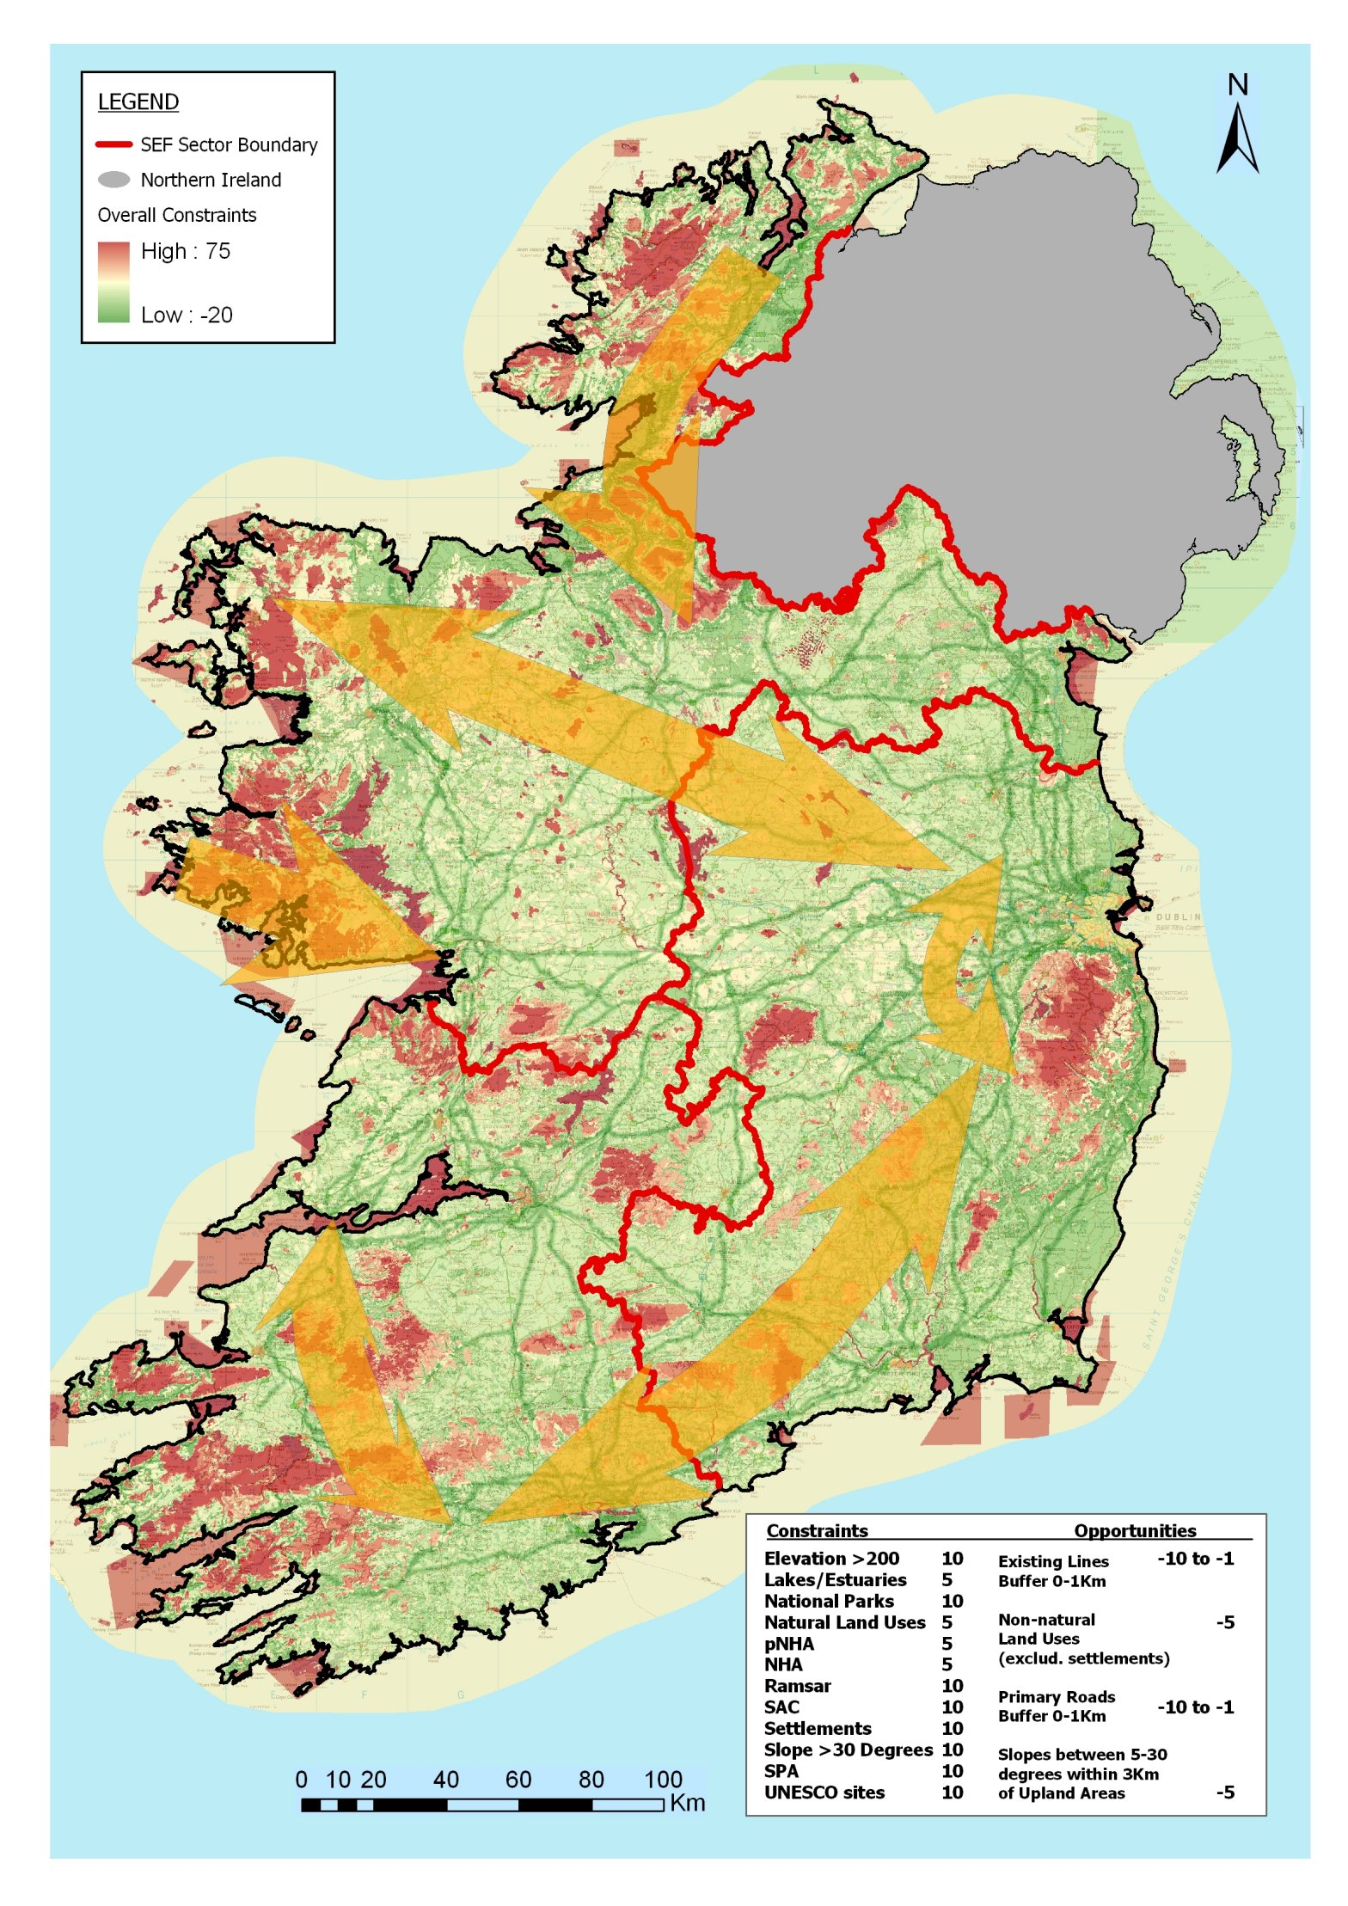
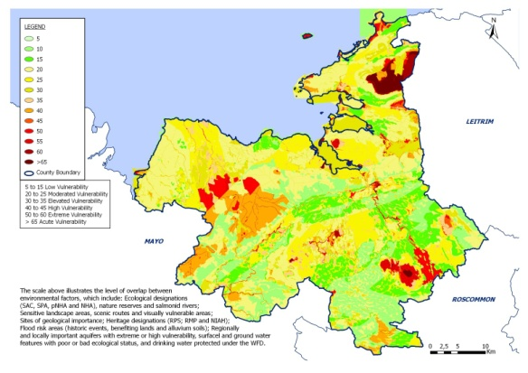
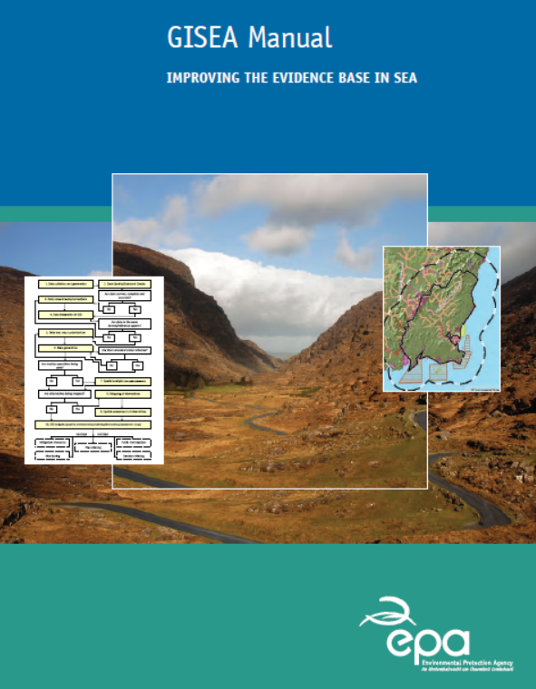
GIS for SEA Manual - EPA

Slide 4
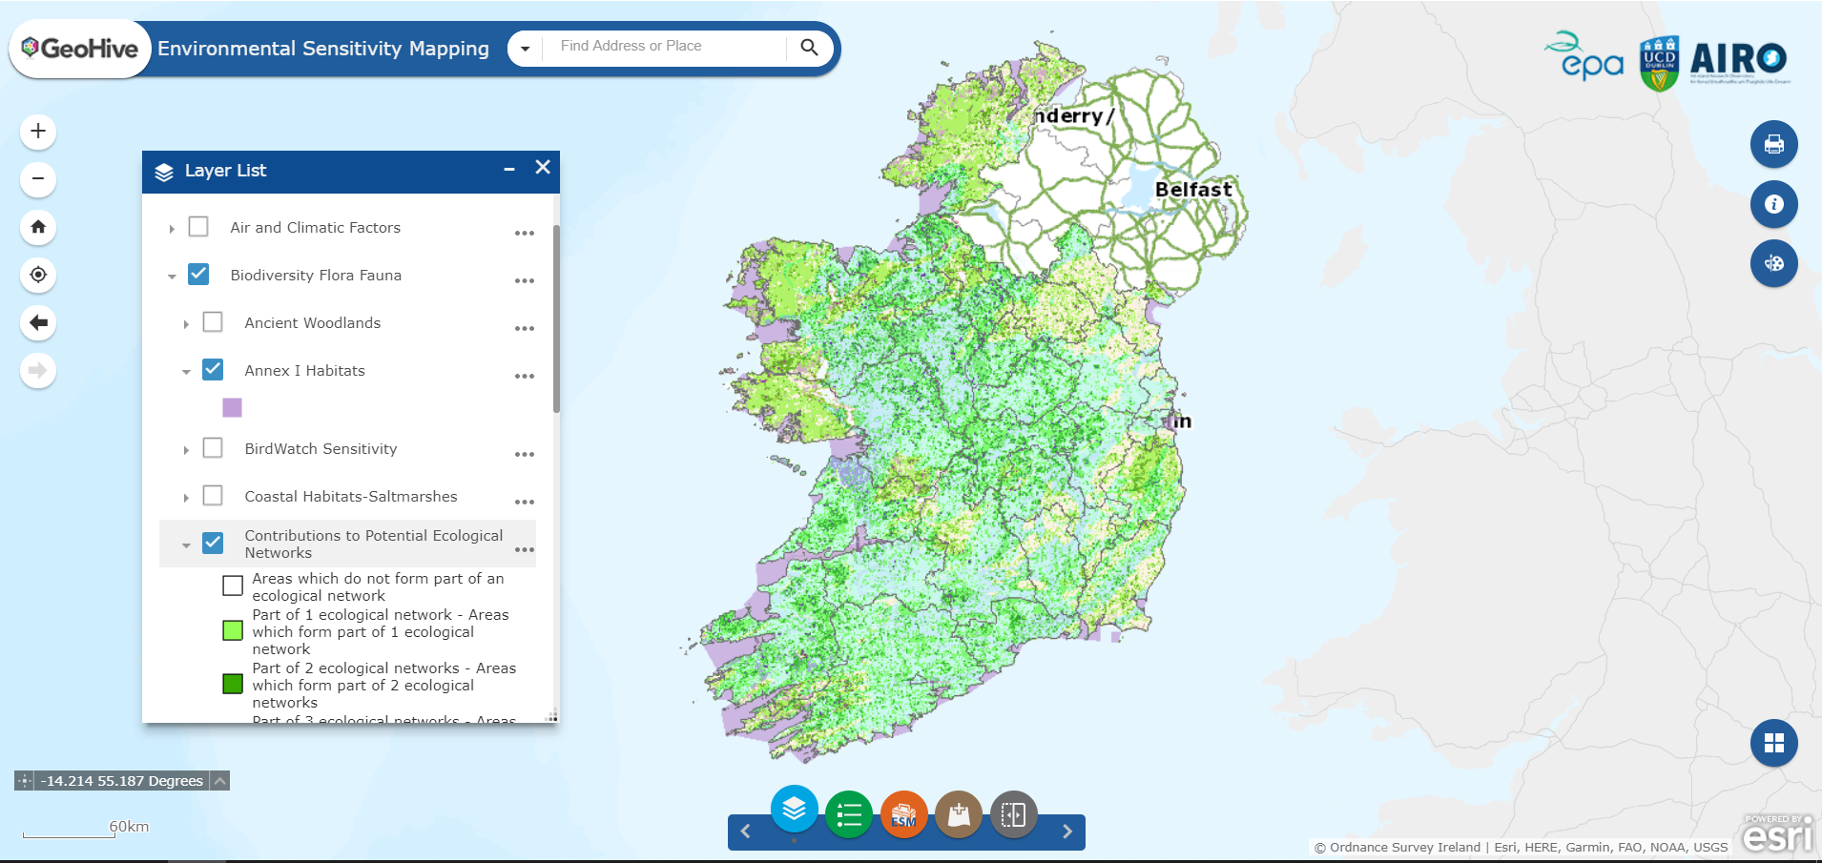
Data Viewer
Access, Visualisation, Discovery

Slide 5
Air and Climate
Air zones Coal restricted areas Historical flood extents Soil carbon (eco serv) Vegetation carbon (eco serv) Water retention (eco serv) Wind speeds
Biodiversity, Flora & Fauna
Ancient woodlands Annex I habitats (Habitats Direct) Birdwatch sensitivity (to windfarms) Coastal habitats – Saltmarshes Contributions to pot. ecological networks (eco serv) Forest inventory Legally protected and policy relevant species (eco serv) Margaritifera sensitive areas Natural Heritage Areas (NHAs) Proposed NHAs Salmonid waters Special Areas of Conservation (SACs) Special Protection Areas (SPAs) Terrestrial biodiversity (eco serv) Woodland habitats
Cultural Heritage
Irish landmark trust Museums, collections and archives NIAH Sites and Monuments Record Walled towns World Heritage Sites
Landscape
Landscape character areas Seascape character areas Seascape visual resource assessment
Material Assets
Active quarries Airfields and airports Broadband access Current wind farms Discharge licences Extractive industries register Historic mine districts IPPC licences Landfill sites Licensed waste facilities Ports Railway network Road network Settlements Waste water treatment plants and status
Population and Human Health
Disability General health Pobal HP Deprivation Index Housing stock (vacant & holiday homes) Travel to work >30min and >1hr Labour force unemployed Population change (percentage and total) Population density per Km² WFD RPA Drinking water (lakes, rivers and groundwater)
Over 130 SEA-relevant
Geospatial datasets
Soils and Geology
Bedrock CORINE landcover Geoparks Geosites Landslide events and susceptibility Mineral locations Outcrops Peat bogs Soil permeability Soils
Water
Aquifer vulnerability Bedrock aquifer Biological Q values Hydrometric areas Groundwater source protection areas Wetlands Water abstraction points WFD high status objectives WFD risk WFD status WFD RPA: Nutrient sensitive WFD RPA: Recreational waters WFD RPA: Shellfish areas WFD RPA: Water dependent habitats (SACs, SPAs) Water management Units

Slide 6
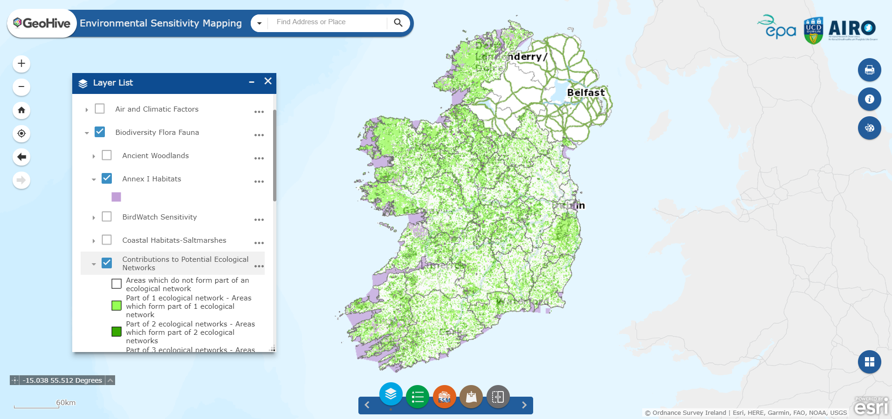
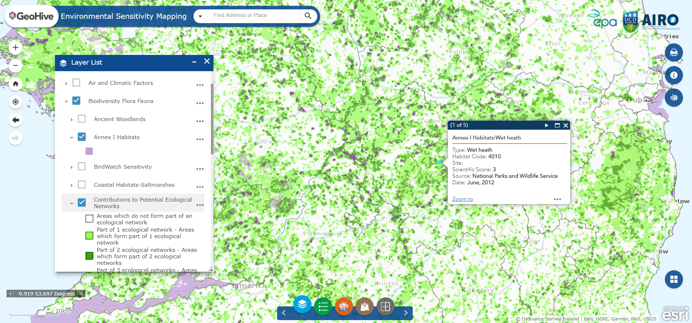
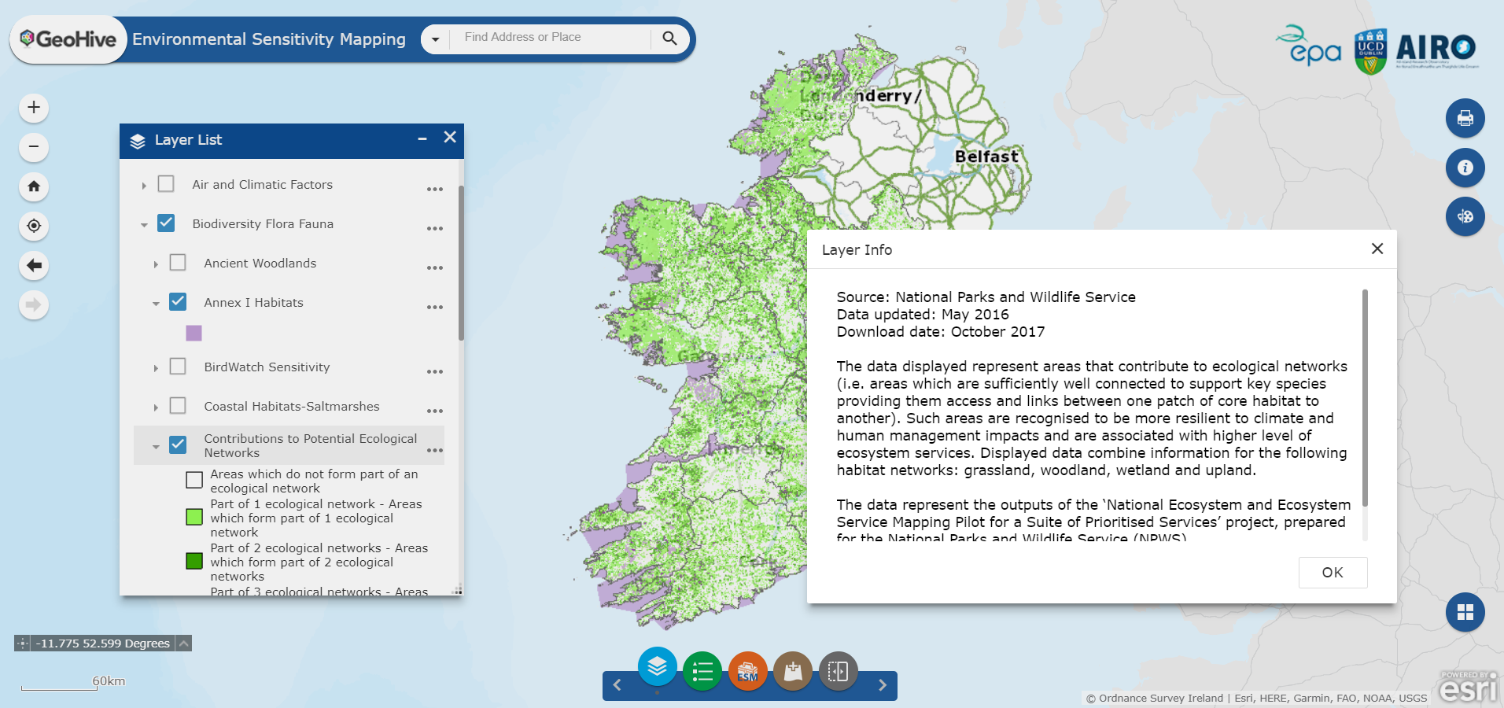
Data Viewer
Access, Visualisation, Discovery

Slide 7
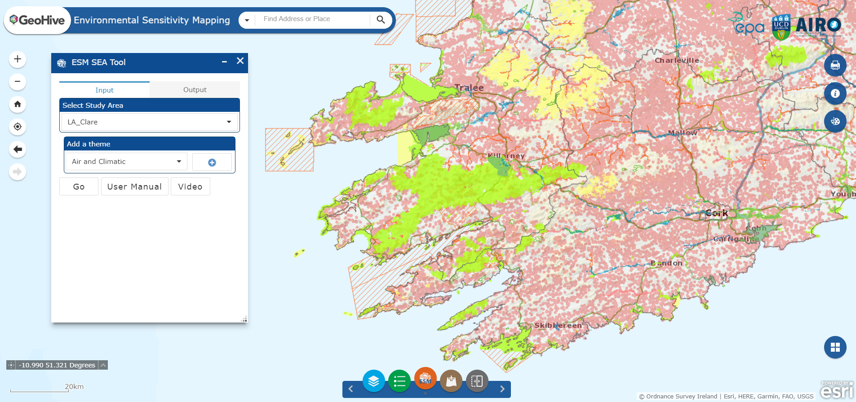
ESM Widget
Bespoke geoprocessing tool
A
B
D
C

Slide 8
SEA and Planning Support Tool
Evidence-based assessments and decisions
As good/robust as available data
Efficiency…time and cost savings
Good governance - consistency, transparency, comparability
Key Data Limitations
Landscape characterisation
Habitat Mapping
Soil productivity
Ecosystem services – grannularity/comprehensiveness
National coverage of other relevant datasets

Slide 9
www.enviromap.ie
ainhoa.gonzalez@ucd.ie

